Slide 1
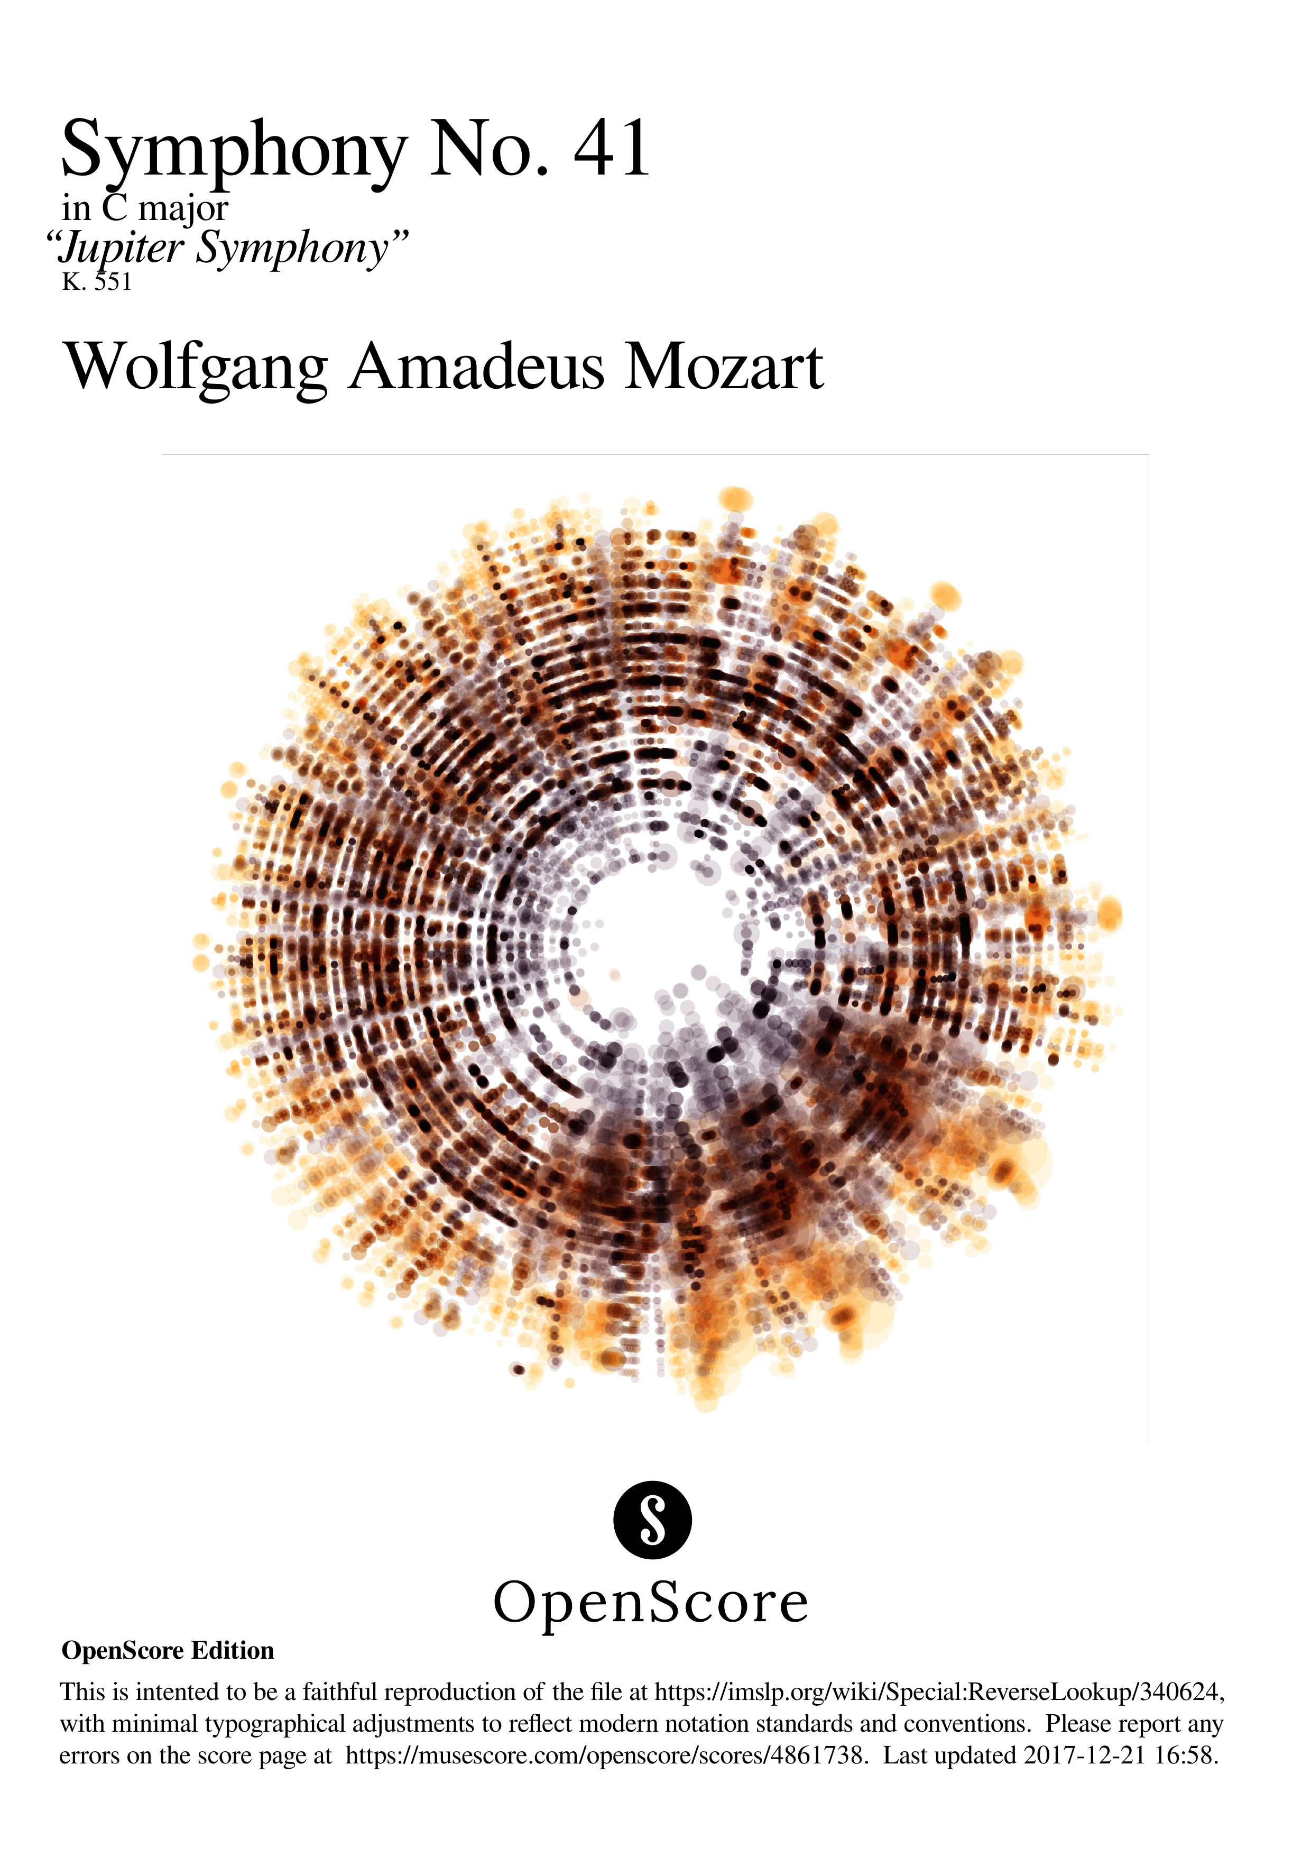

Slide 2
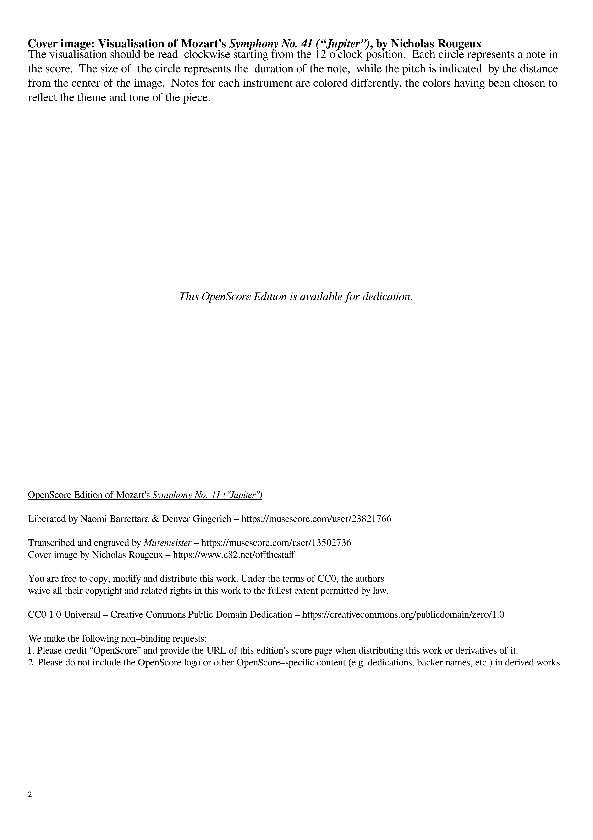

Slide 3
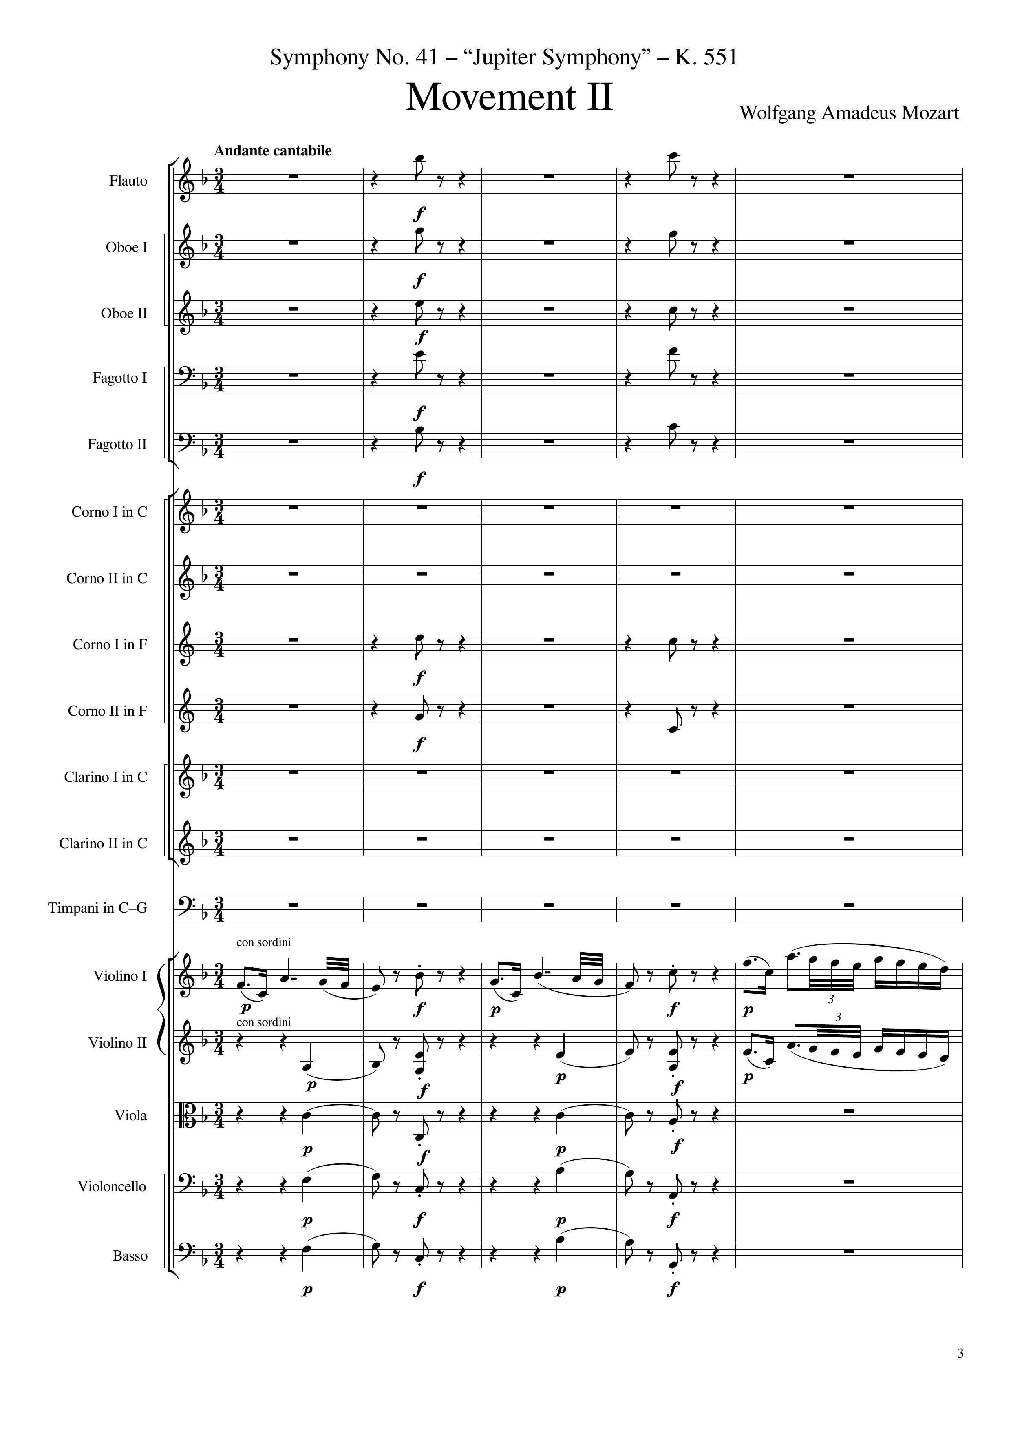
rhythm+harm
rhythm+harm
rhythm+harm
rhythm+harm
rhythm+harm
rhythm+harm
rhythm+harm
rhythm+harm
rhythm+harm
rhythm+harm
rhythm+harm
rhythm+harm
rhythm+harm
rhythm+harm
mel
rhythm+harm
mel
rhythm+harm
mel
harm
rhythm+harm
harm
rhythm+harm
mel
harm
rhythm+harm
harm
rhythm+harm
harm
rhythm+harm
harm
rhythm+harm
harm
rhythm+harm
harm
rhythm+harm
0
15
Notes:
13:35

Slide 4
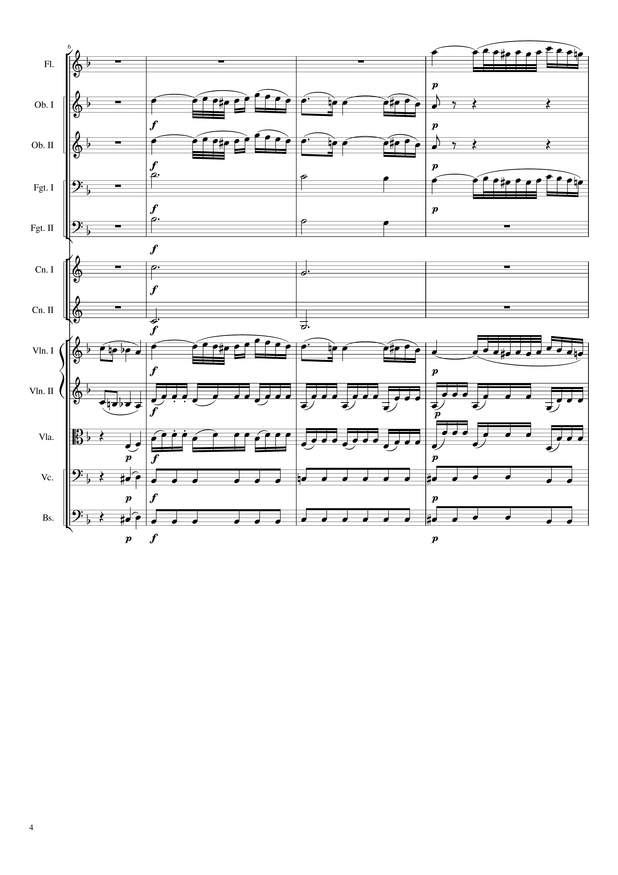
mel
mel
mel
harm
mel
harm
harm
harm
mel
mel
mel
rhythm
harm
rhythm
harm
rhythm
harm
rhythm
15
27

Slide 5
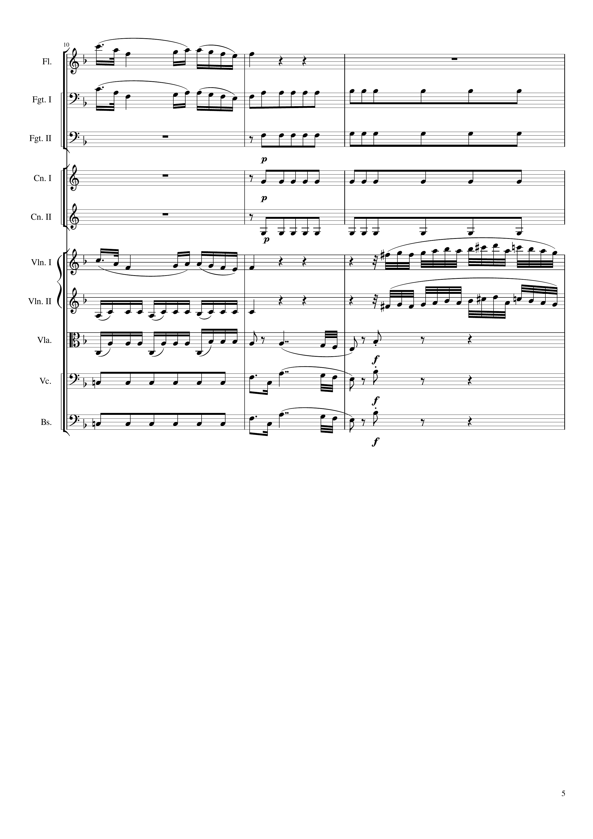
mel
mel
rhythm
rhythm
rhythm
rhythm
mel
mel
rhythm
mel
rhythm
mel
rhythm+harm
rhythm
mel
rhythm+harm
rhythm
mel
rhythm+harm
27
36

Slide 6
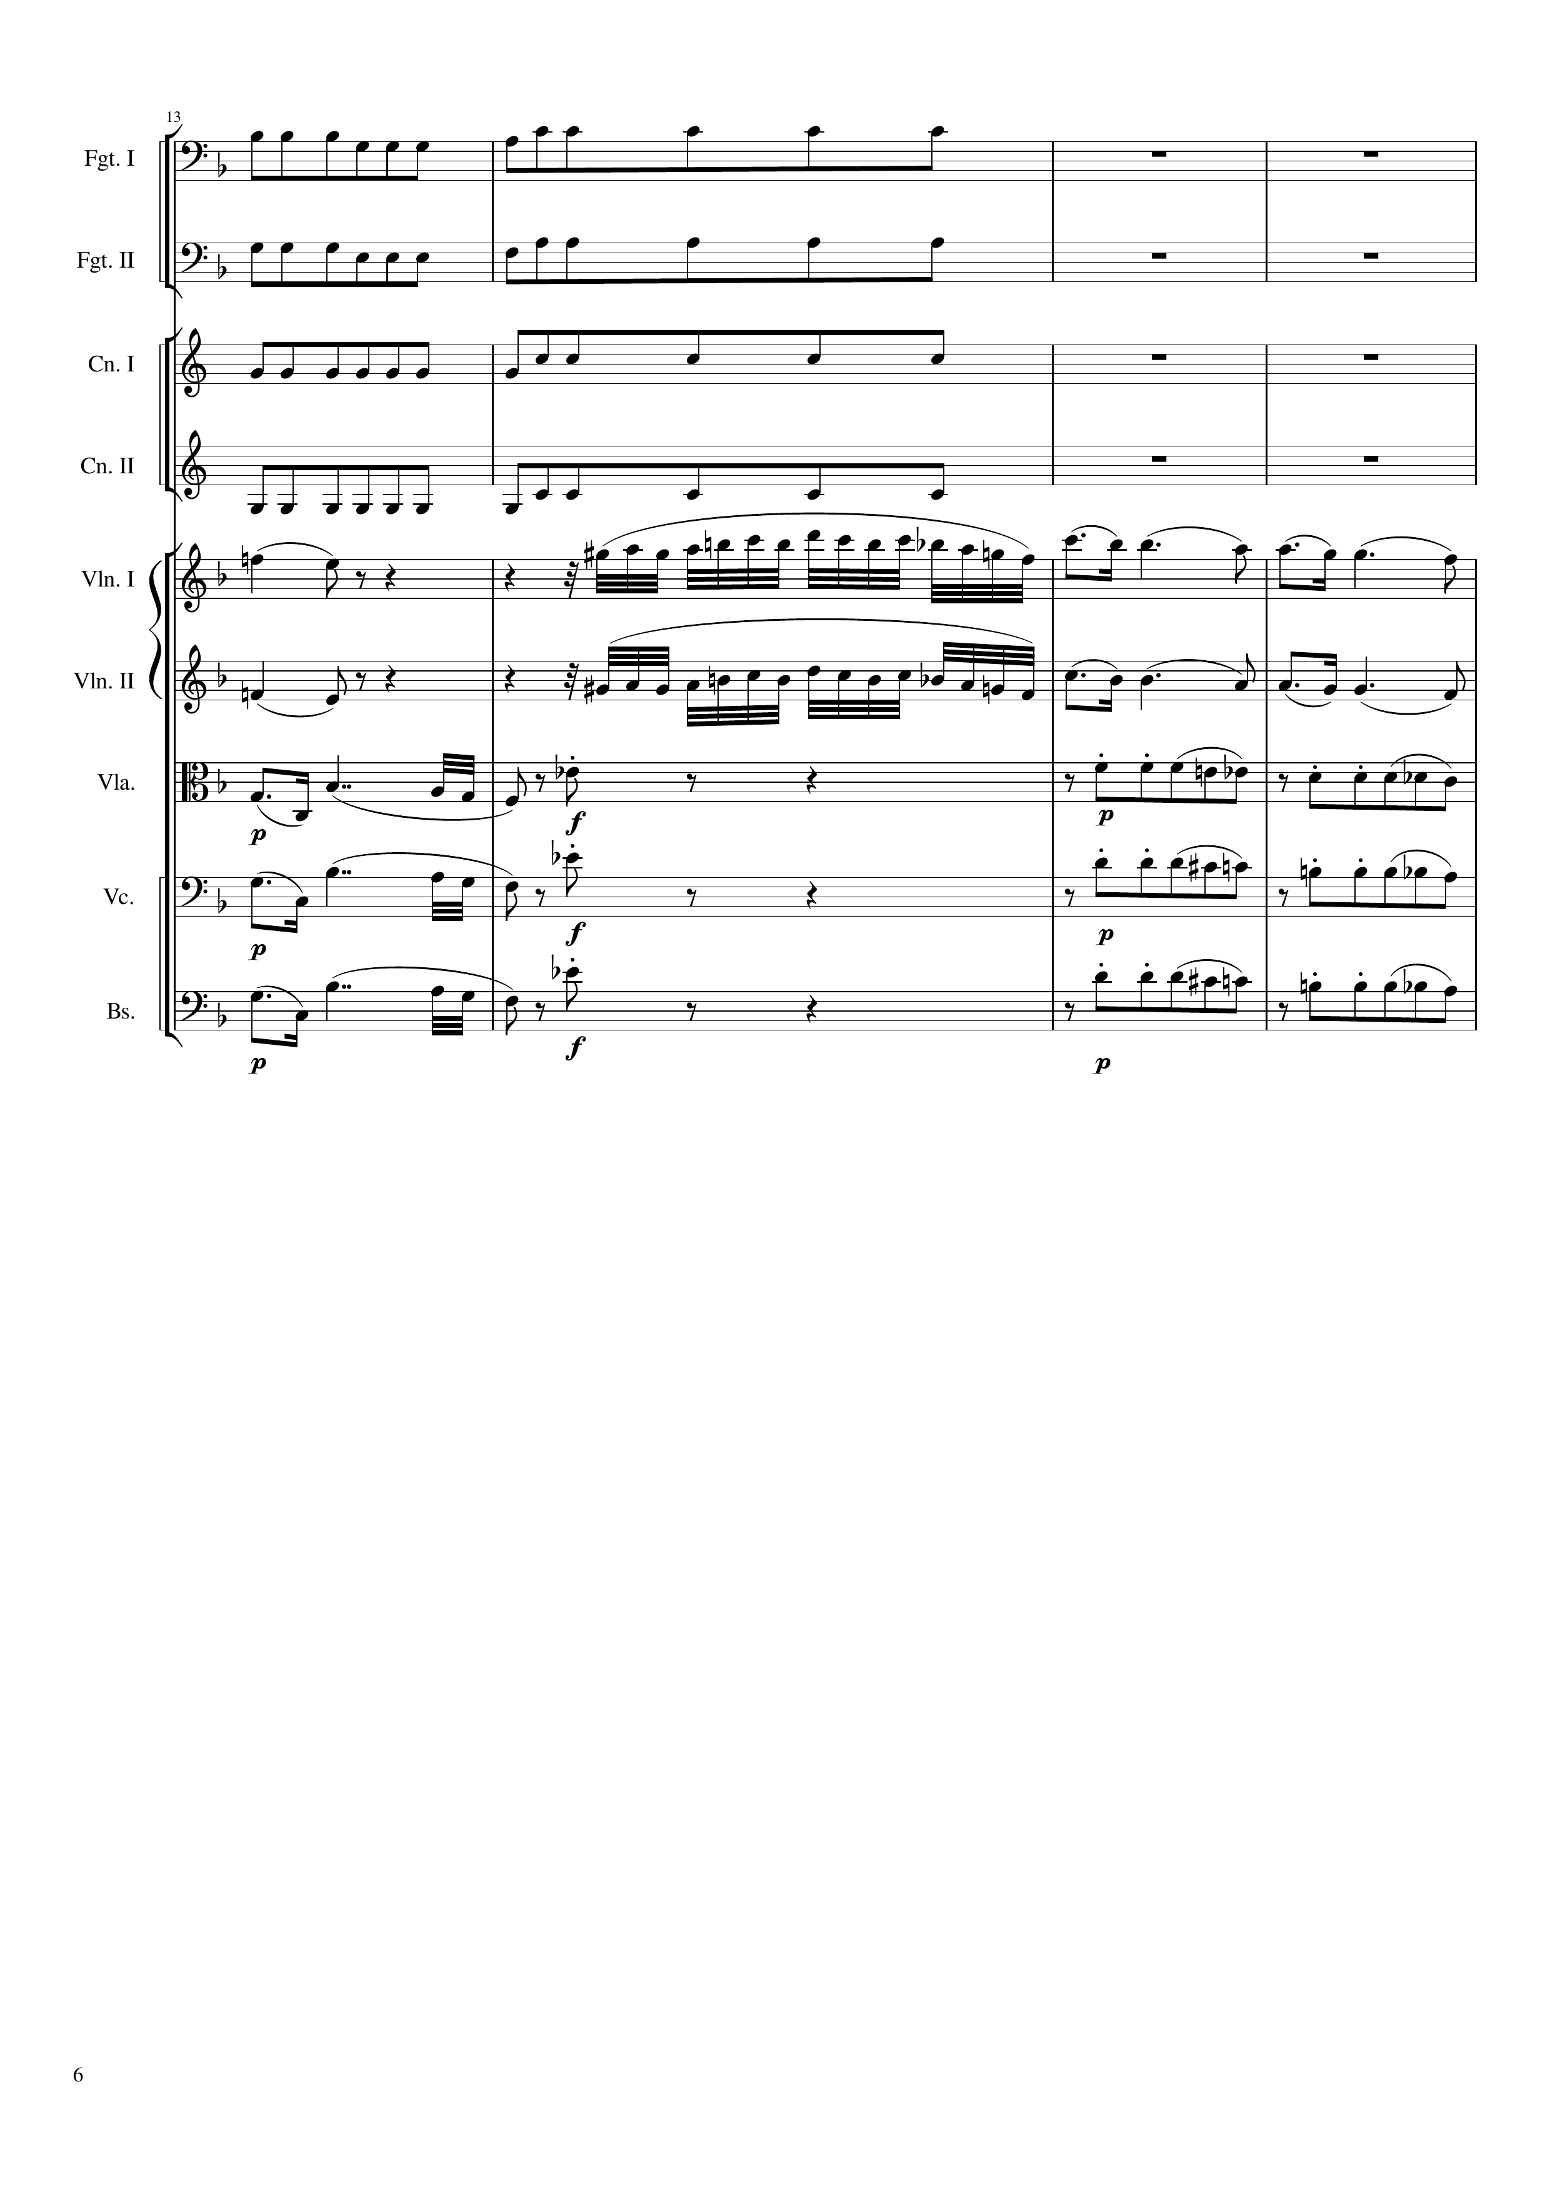
rhythm
rhythm
rhythm
rhythm
mel
mel
mel
mel
mel
rhythm+harm
rhythm
mel
rhythm+harm
rhythm
mel
rhythm+harm
rhythm
36
48

Slide 7
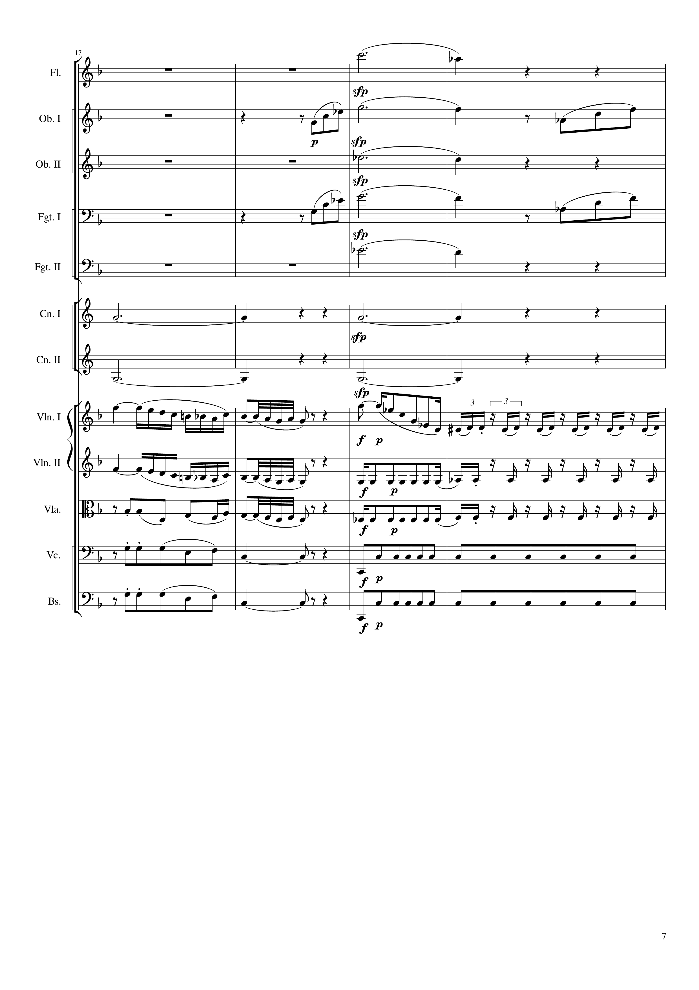
harm
mel
mel
harm
mel
mel
harm
harm
harm
harm
harm
mel
mel
rhythm
mel
rhythm
rhythm
rhythm
rhythm
rhythm
rhythm
rhythm
48
60

Slide 8
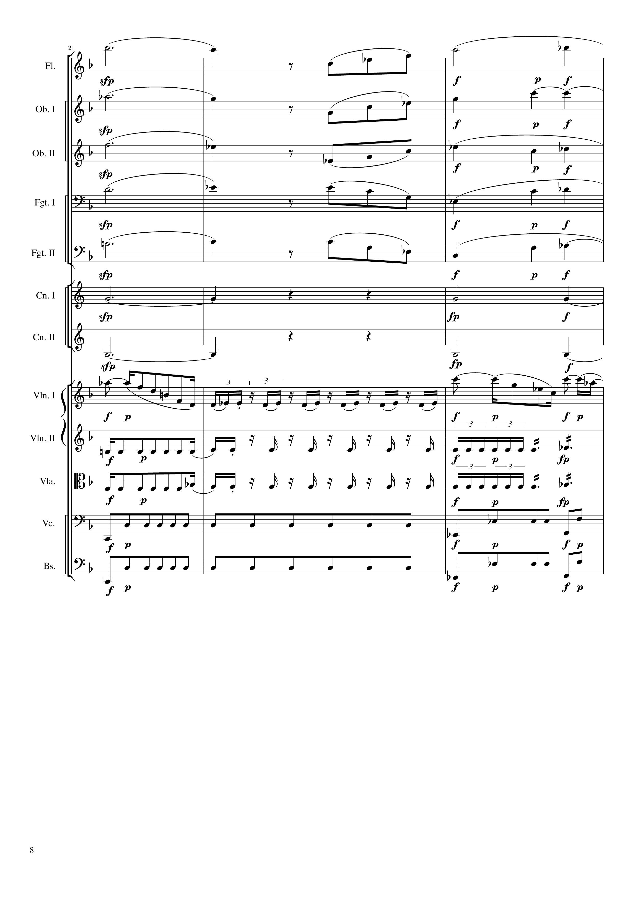
harm
mel
harm
mel
mel
harm
harm
mel
harm
mel
mel
harm
harm
mel
harm
harm
harm
harm
harm
mel
rhythm
mel
rhythm
rhythm
rhythm
rhythm
60
69

Slide 9
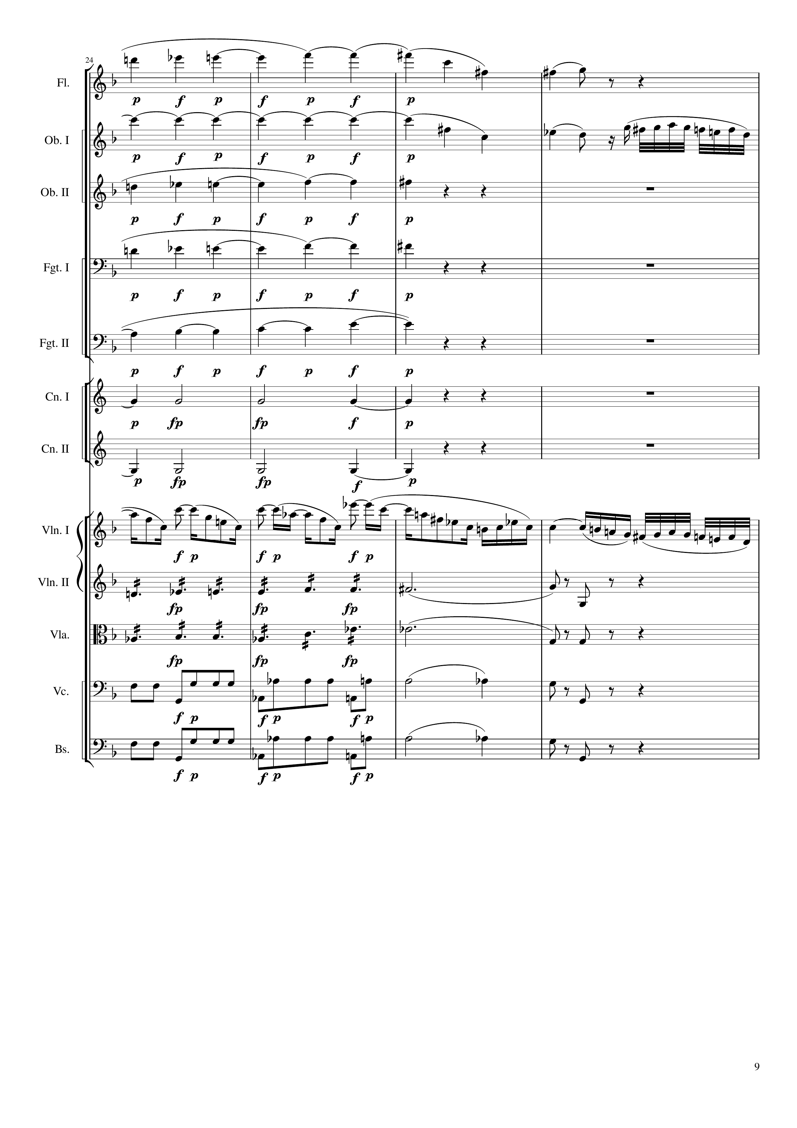
harm
harm
mel
harm
harm
harm
harm
harm
mel
rhythm
harm
rhythm
harm
rhythm
harm
rhythm
harm
69
75
81

Slide 10
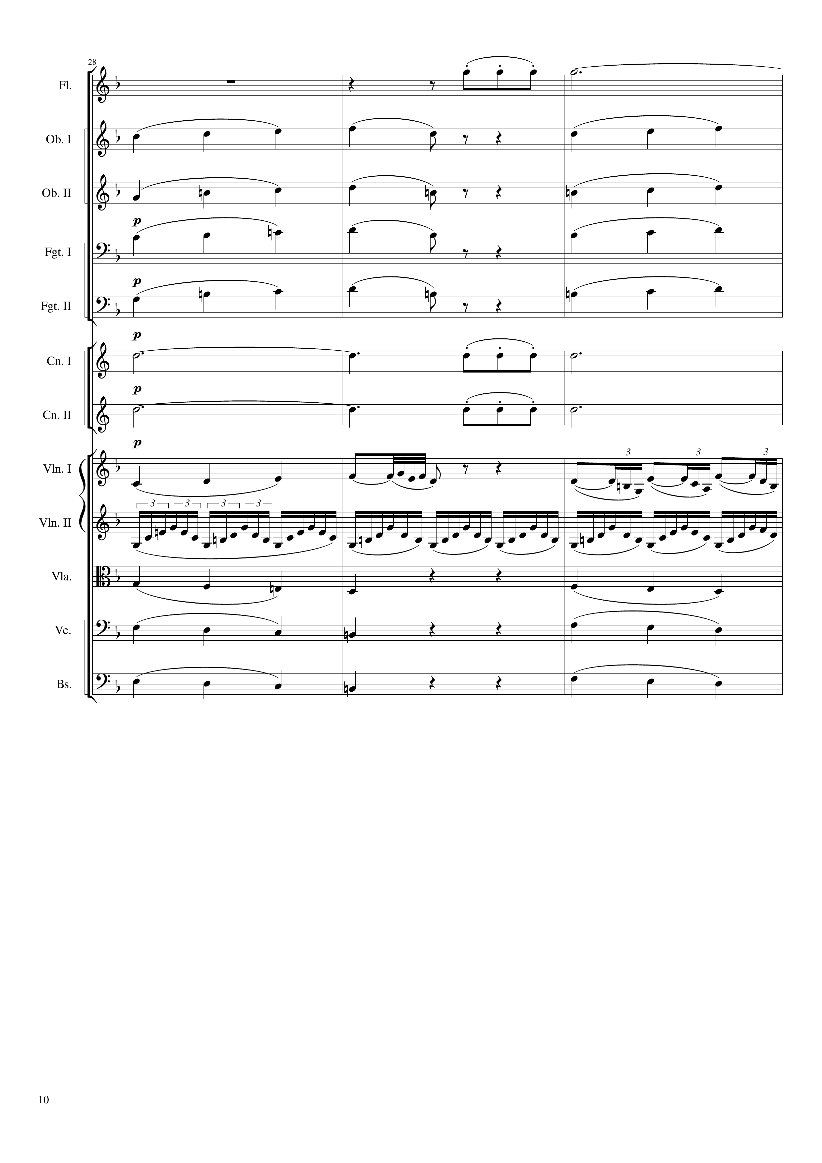
rhythm+harm
harm
mel
mel
mel
mel
mel
mel
mel
mel
harm
rhythm+harm
harm
harm
rhythm+harm
harm
mel+rhythm
mel+rhythm
rhythm
mel+harm
mel+harm
mel+harm
mel+harm
mel+harm
mel+harm
81
90

Slide 11
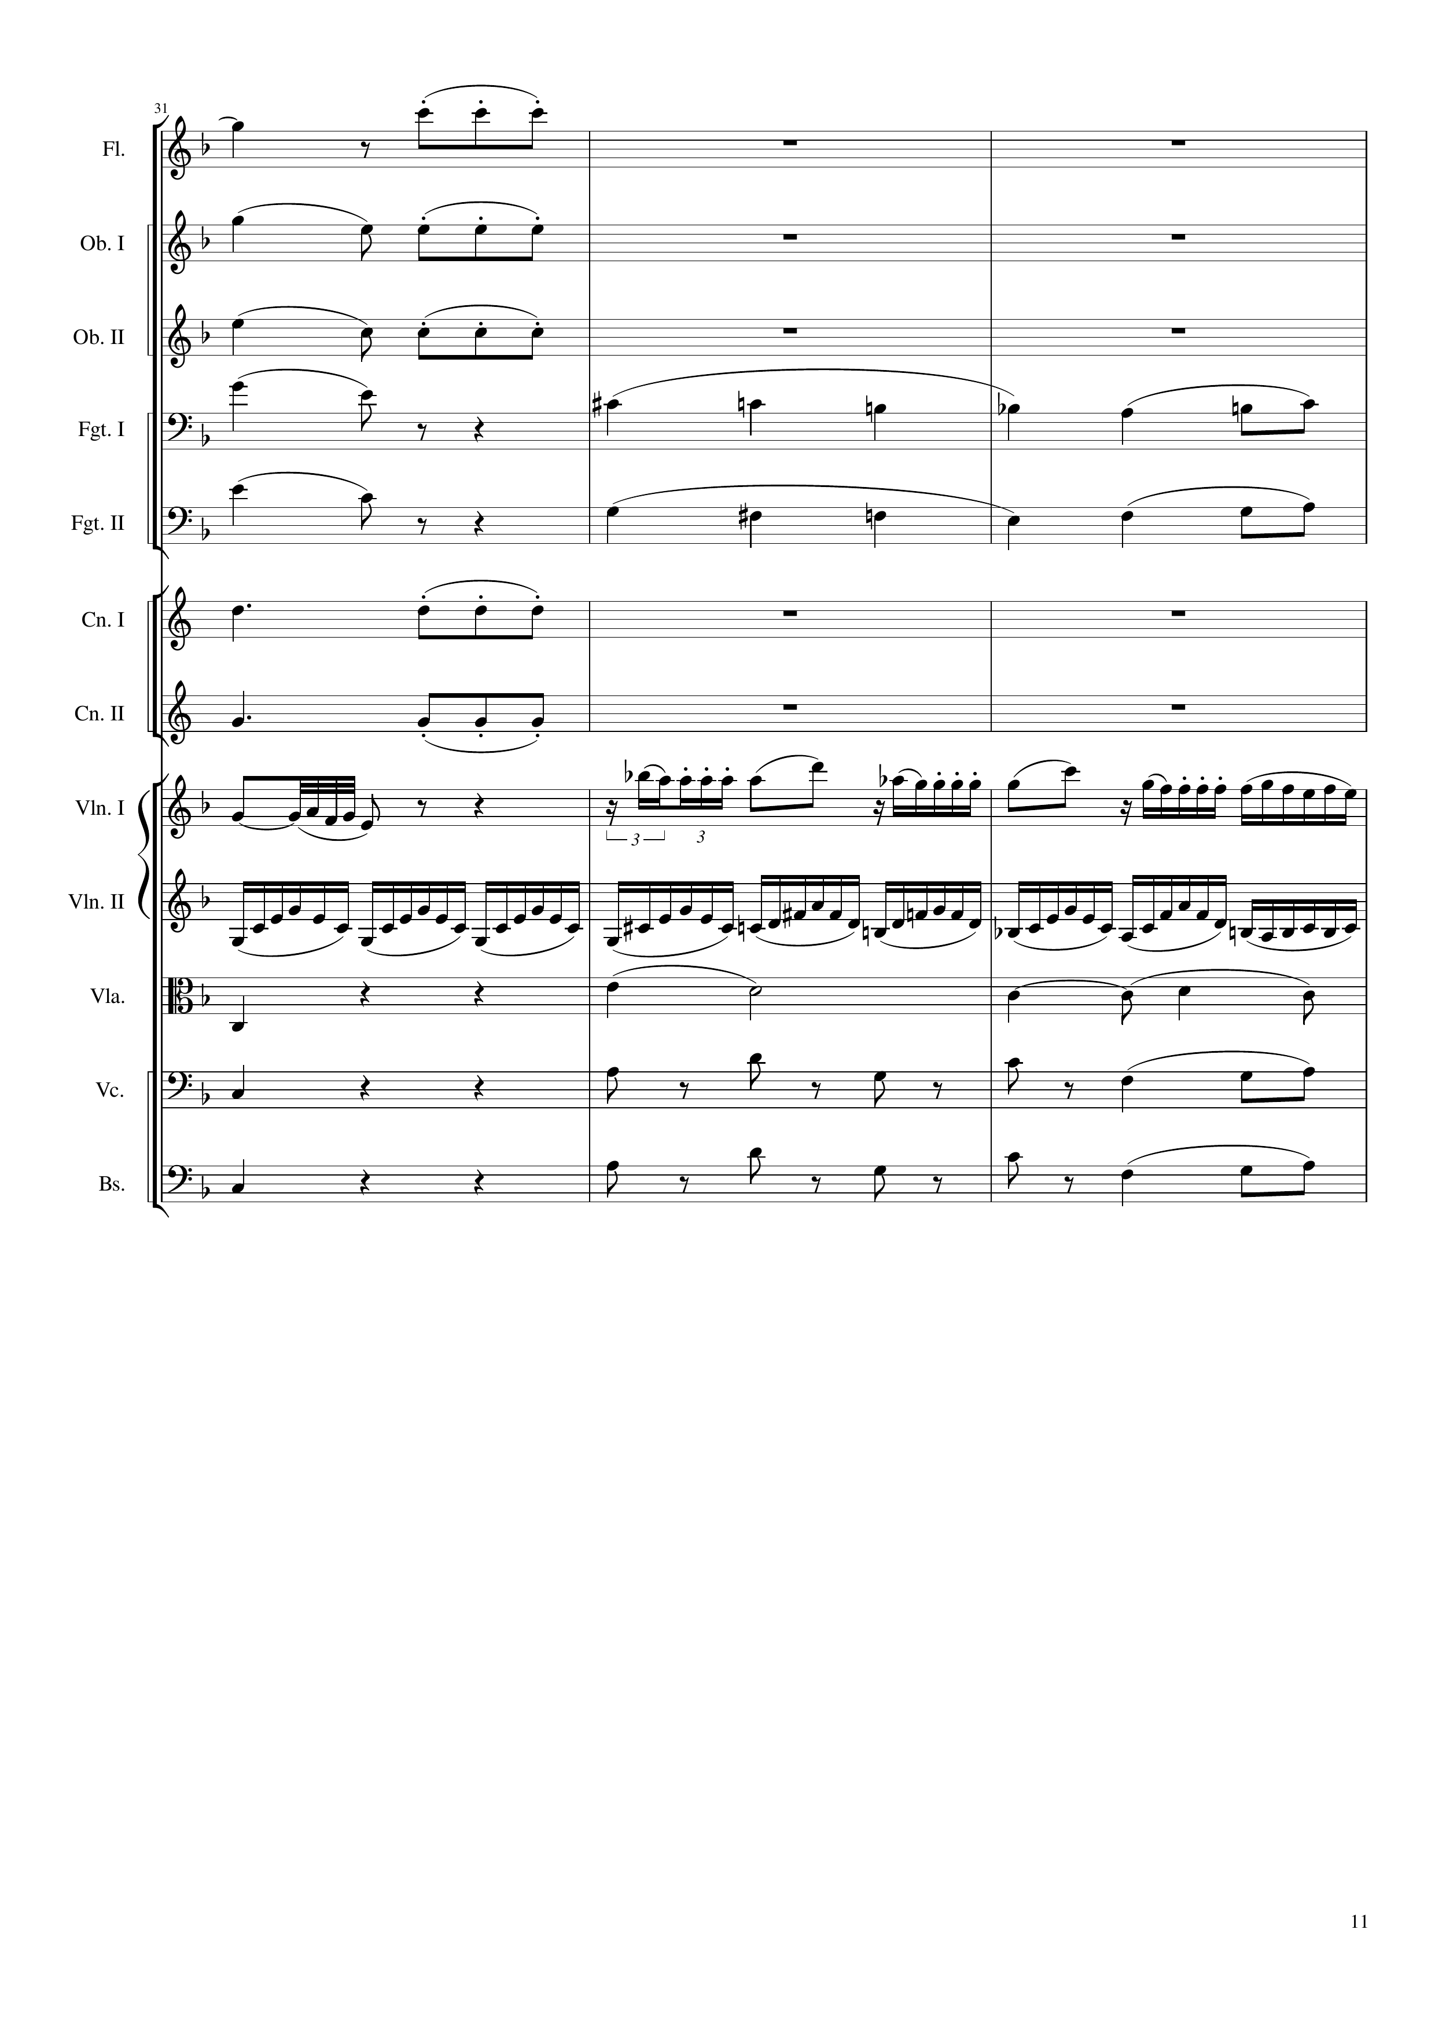
harm
rhythm+harm
mel
rhythm+harm
mel
rhythm+harm
mel
harm
mel
harm
harm
rhythm+harm
harm
rhythm+harm
mel+rhythm
mel
rhythm
mel+harm
harm
mel+harm
rhythm+harm
harm
mel+harm
rhythm+harm
harm
90
99

Slide 12
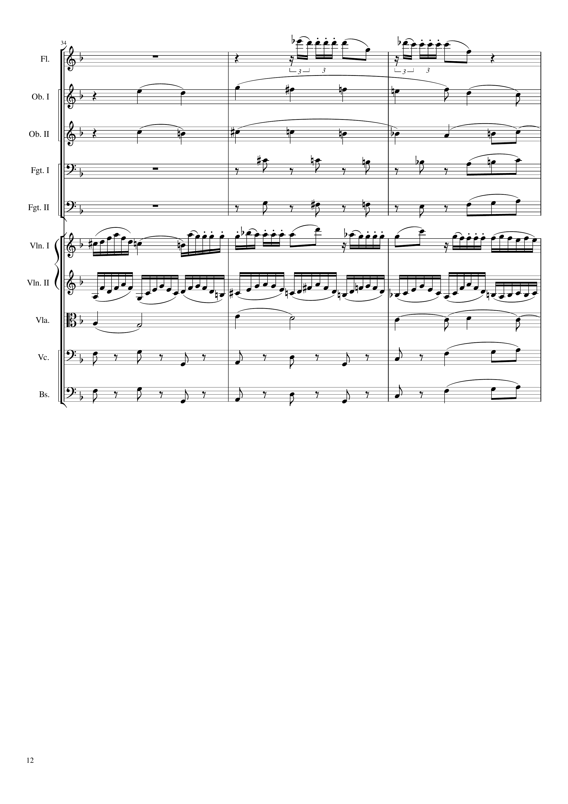
mel
harm
harm
rhythm+harm
mel+harm
rhythm+harm
mel+harm
mel
rhythm
harm
rhythm+harm
mel+harm
rhythm+harm
mel+harm
99
108

Slide 13
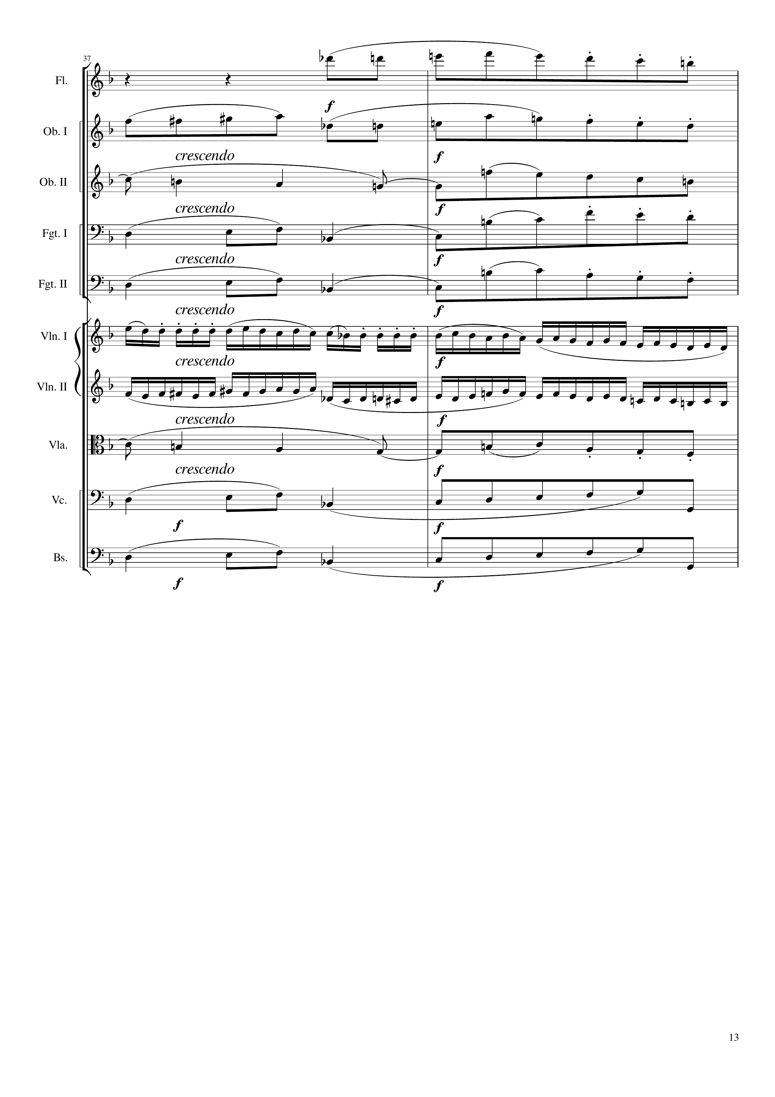
mel
mel
harm
mel
mel+harm
mel+harm
mel
mel+rhythm
harm
mel+harm
mel+harm
mel+harm
108
114
Notes:
16:30

Slide 14
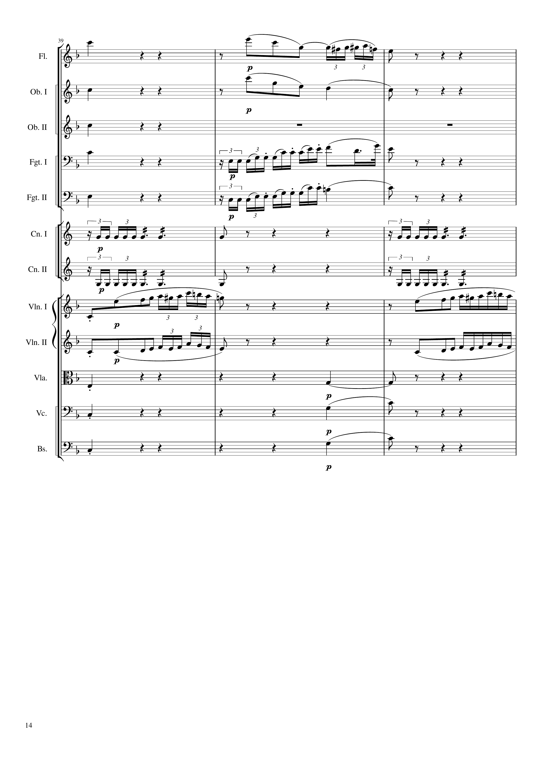
mel
mel
mel
mel
mel
mel+harm
mel
mel+harm
mel
rhythm
rhythm
rhythm
rhythm
mel
mel
mel
mel+rhythm
mel
mel
mel+harm
harm
mel+harm
harm
mel+harm
harm
114
123

Slide 15
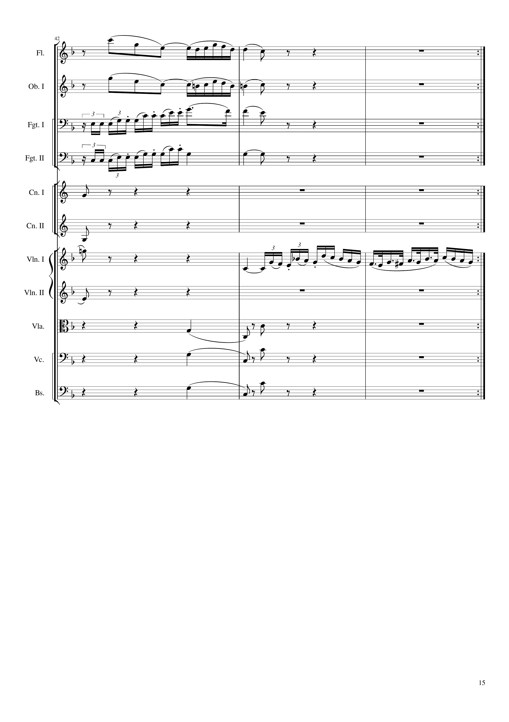
mel
mel
mel
mel
rhythm
rhythm
mel
mel
mel
harm
harm
harm
123
132
264
Notes:
17:15

Slide 16
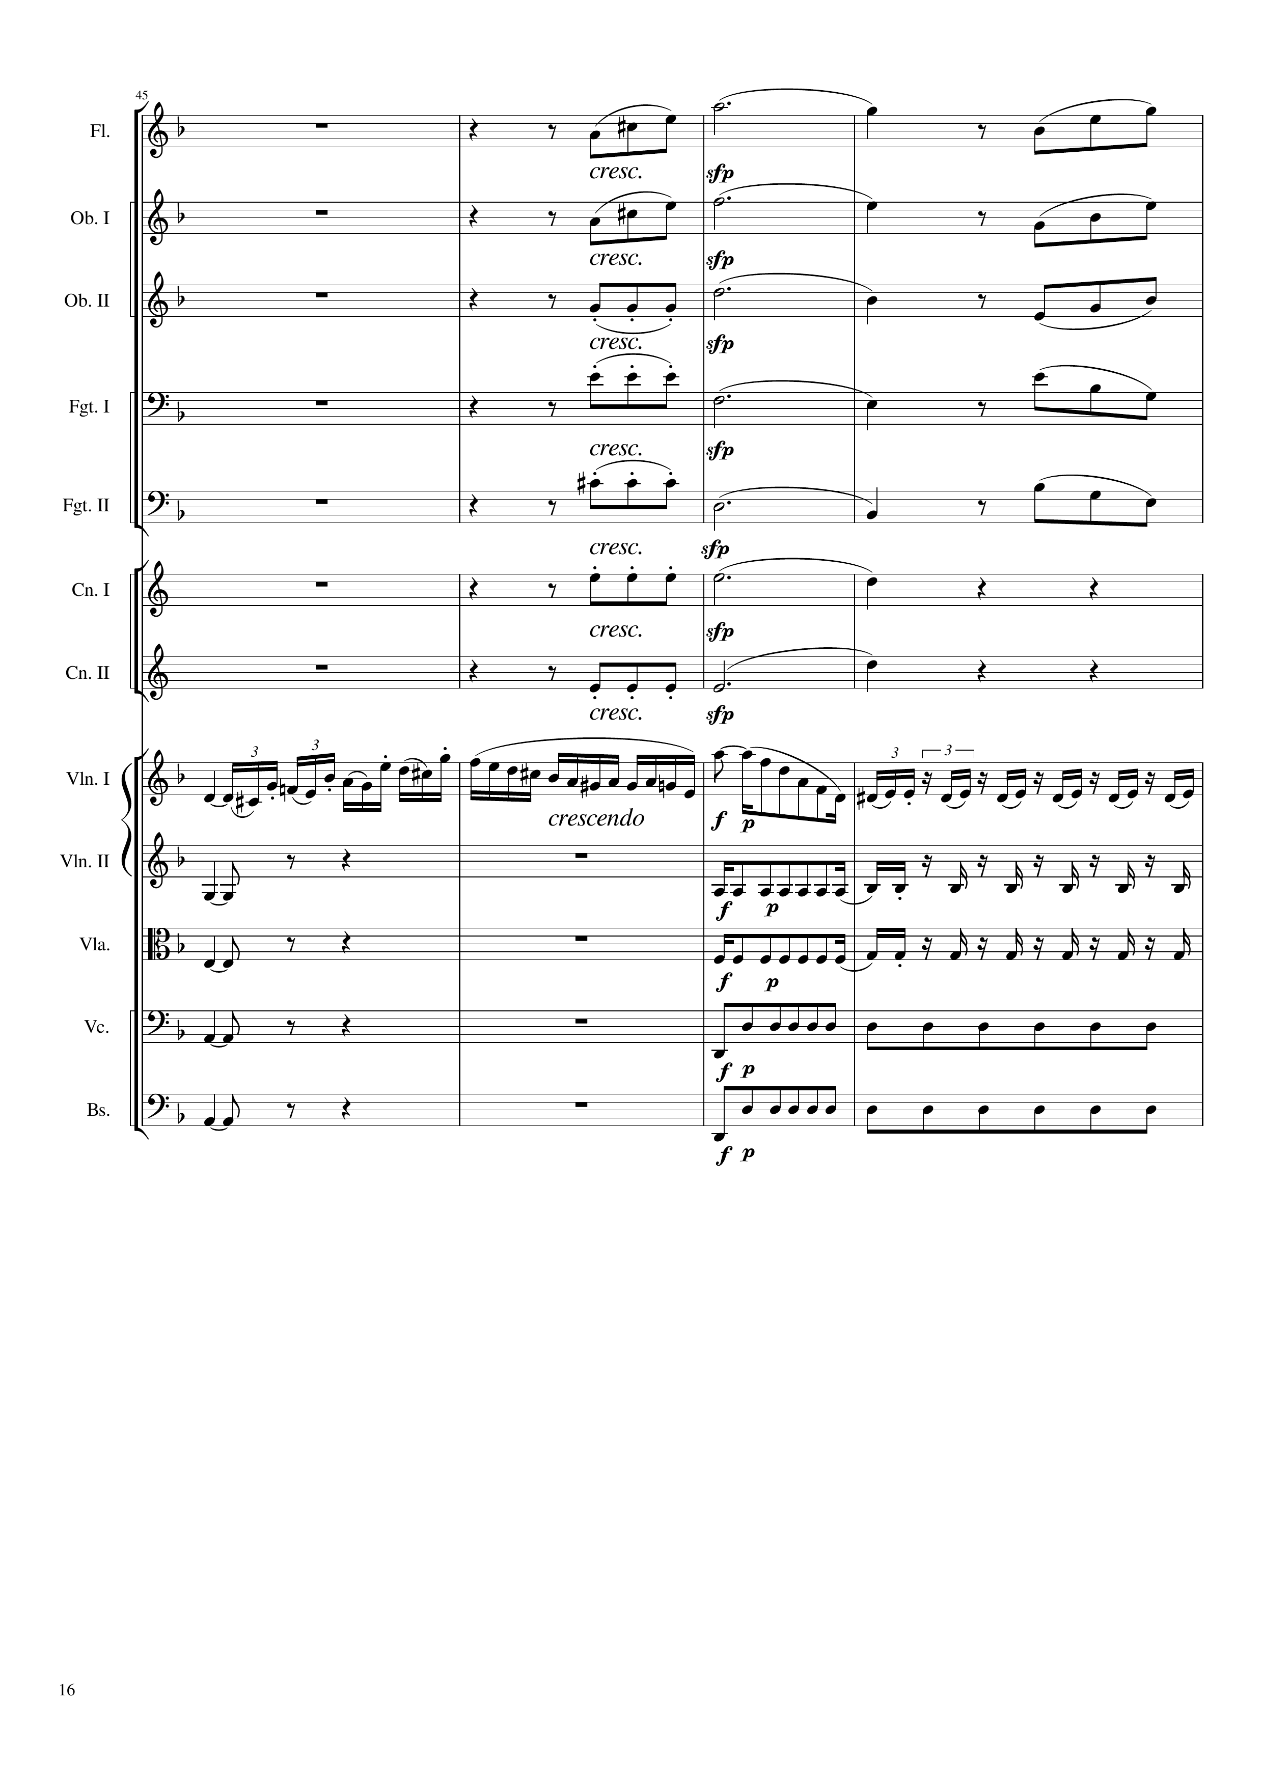
mel
mel
mel+harm
mel+harm
mel+harm
mel+harm
mel+harm
mel+harm
mel+harm
mel+harm
mel+harm
mel+harm
mel
rhythm
harm
rhythm
harm
rhythm
harm
rhythm
harm
rhythm
264
276
Notes:
21:10

Slide 17
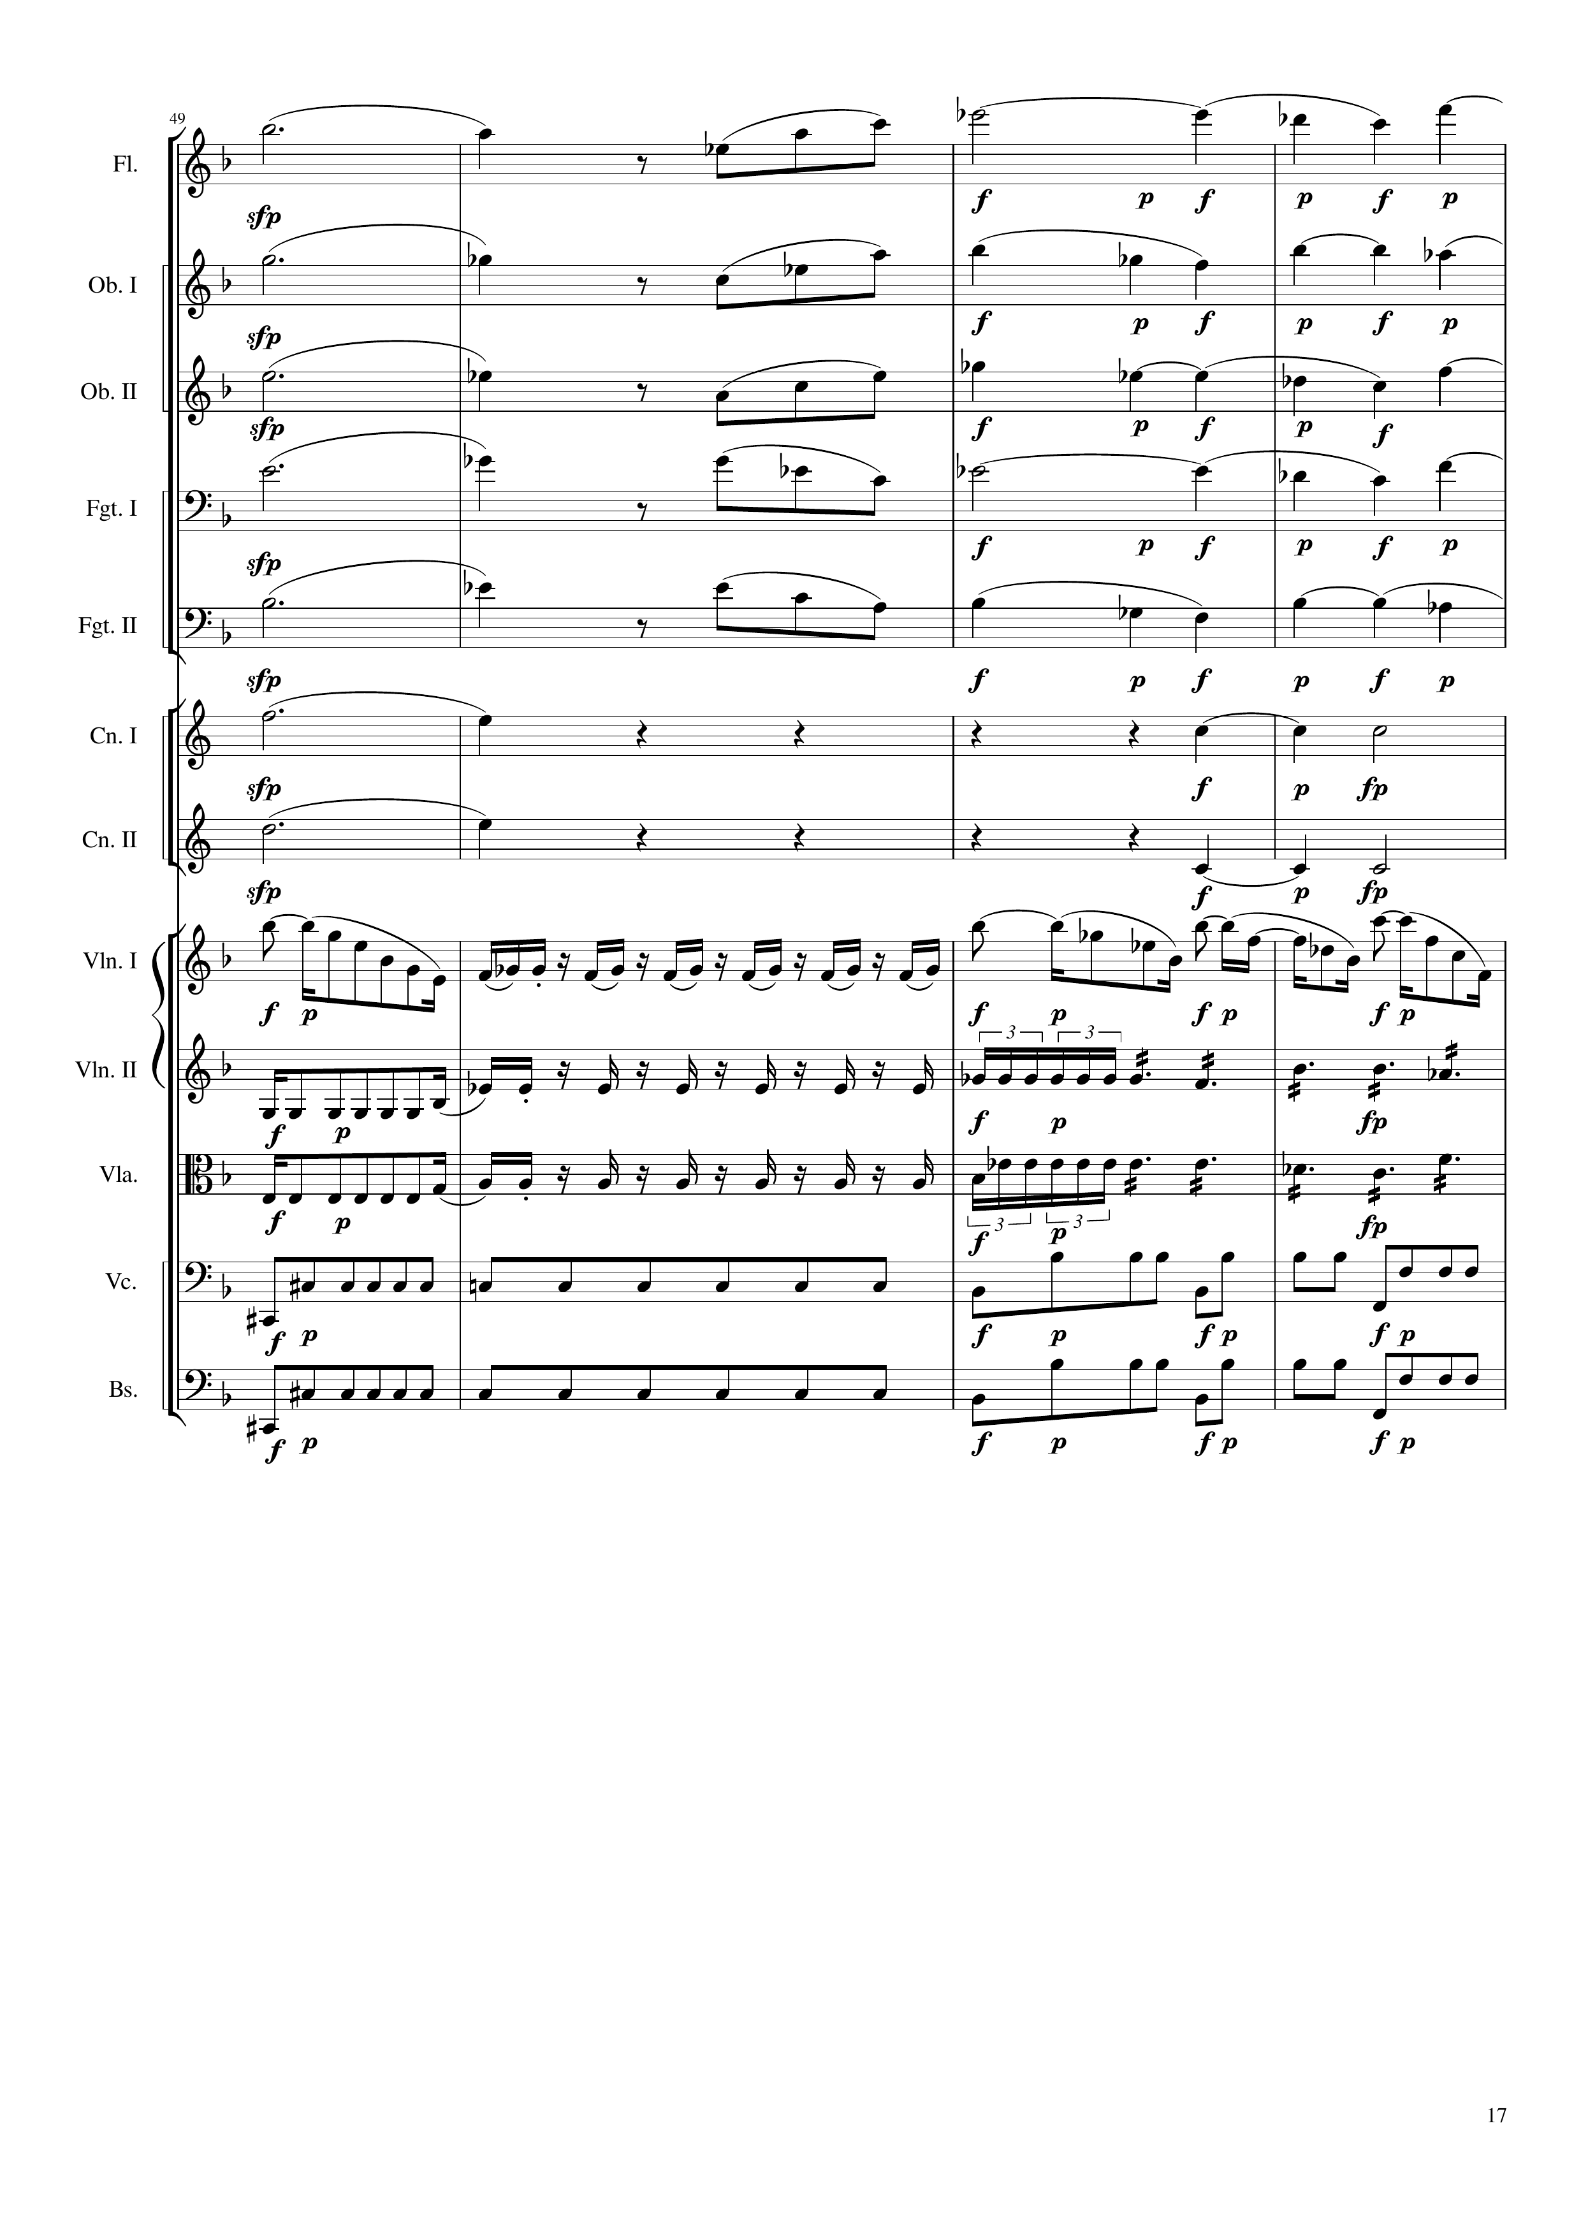
mel
mel
harm
mel+harm
mel
harm
mel+harm
mel
harm
mel+harm
mel
harm
mel+harm
mel
harm
harm
harm
harm
harm
mel
rhythm
mel
rhythm
rhythm
rhythm
rhythm
276
288

Slide 18
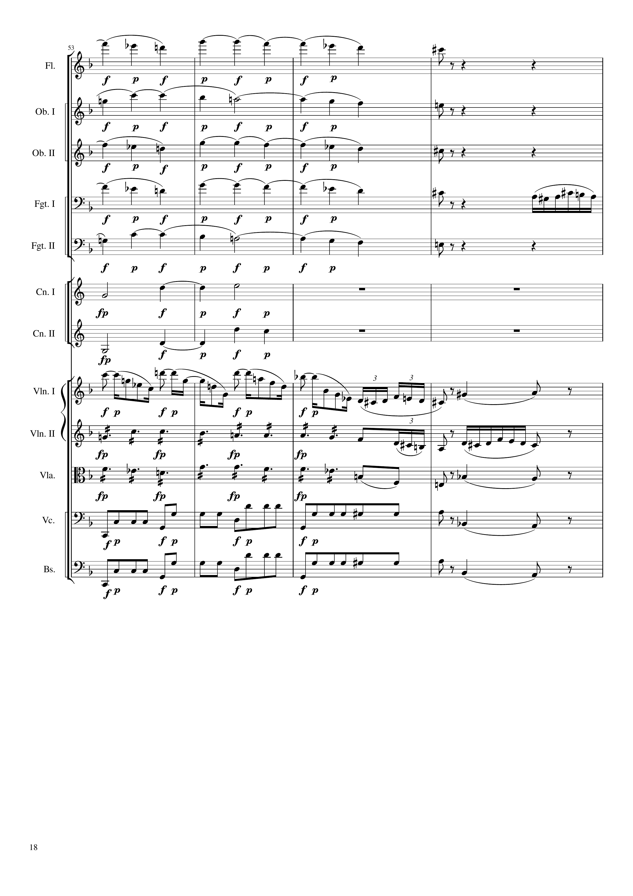
harm
harm
harm
harm
mel
harm
harm
harm
mel
harm
rhythm
mel
rhythm
harm
rhythm
harm
rhythm
harm
288
300

Slide 19
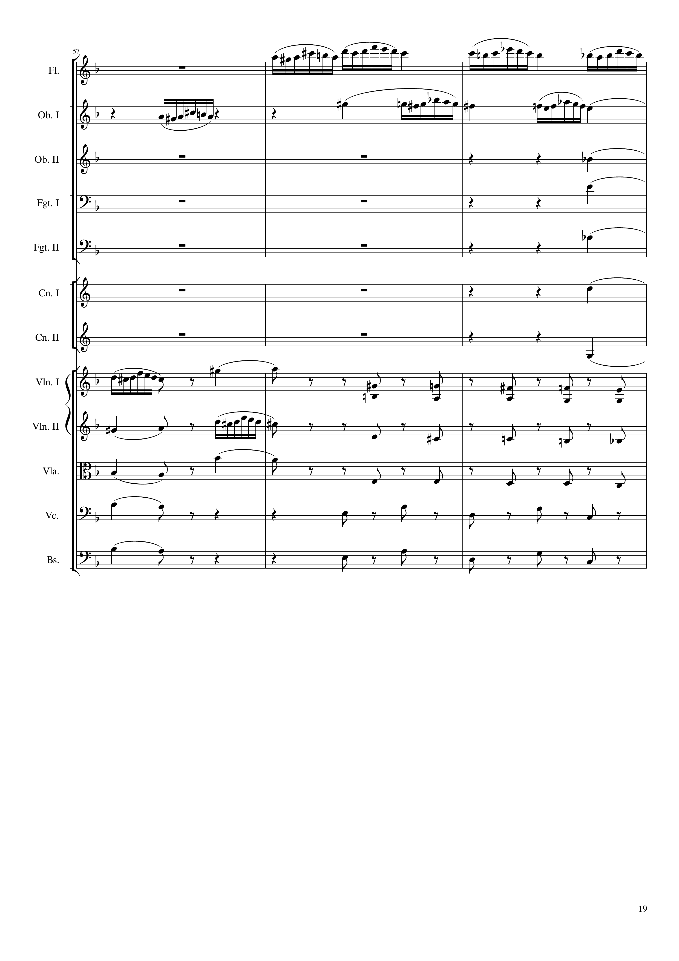
mel
mel
mel
harm
harm
harm
harm
harm
mel
harm
rhythm+harm
harm
mel
rhythm+harm
harm
rhythm+harm
harm
rhythm+harm
harm
rhythm+harm
300
309

Slide 20
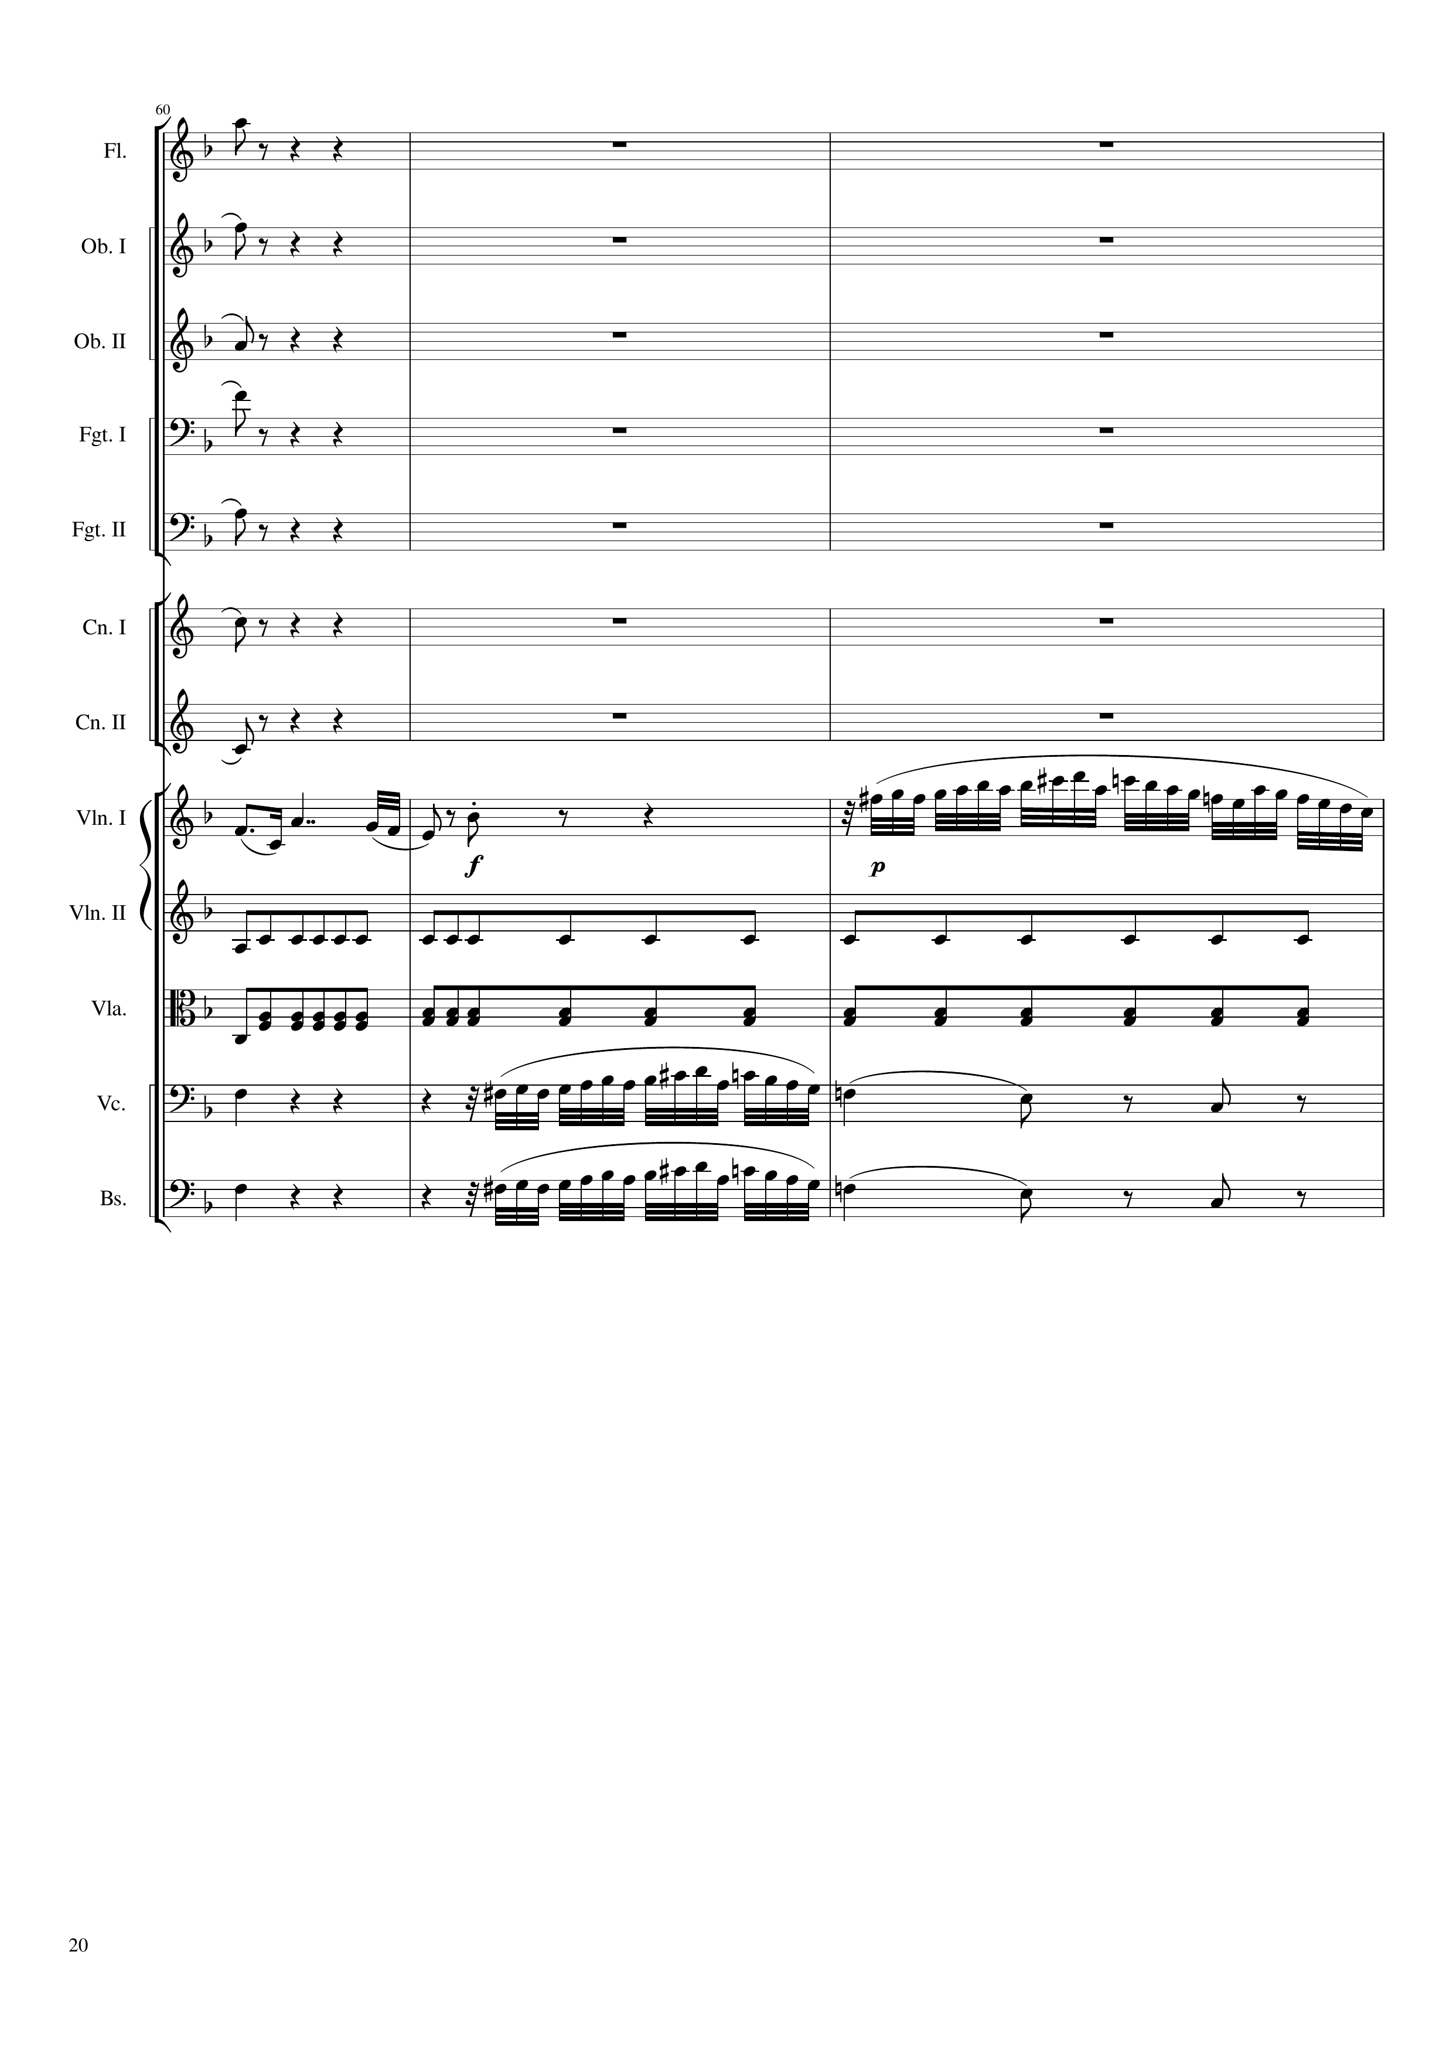
mel
mel
harm
harm
harm
harm
harm
mel
mel
rhythm
rhythm
rhythm+harm
mel
rhythm+harm
rhythm+harm
mel
rhythm+harm
309
318

Slide 21
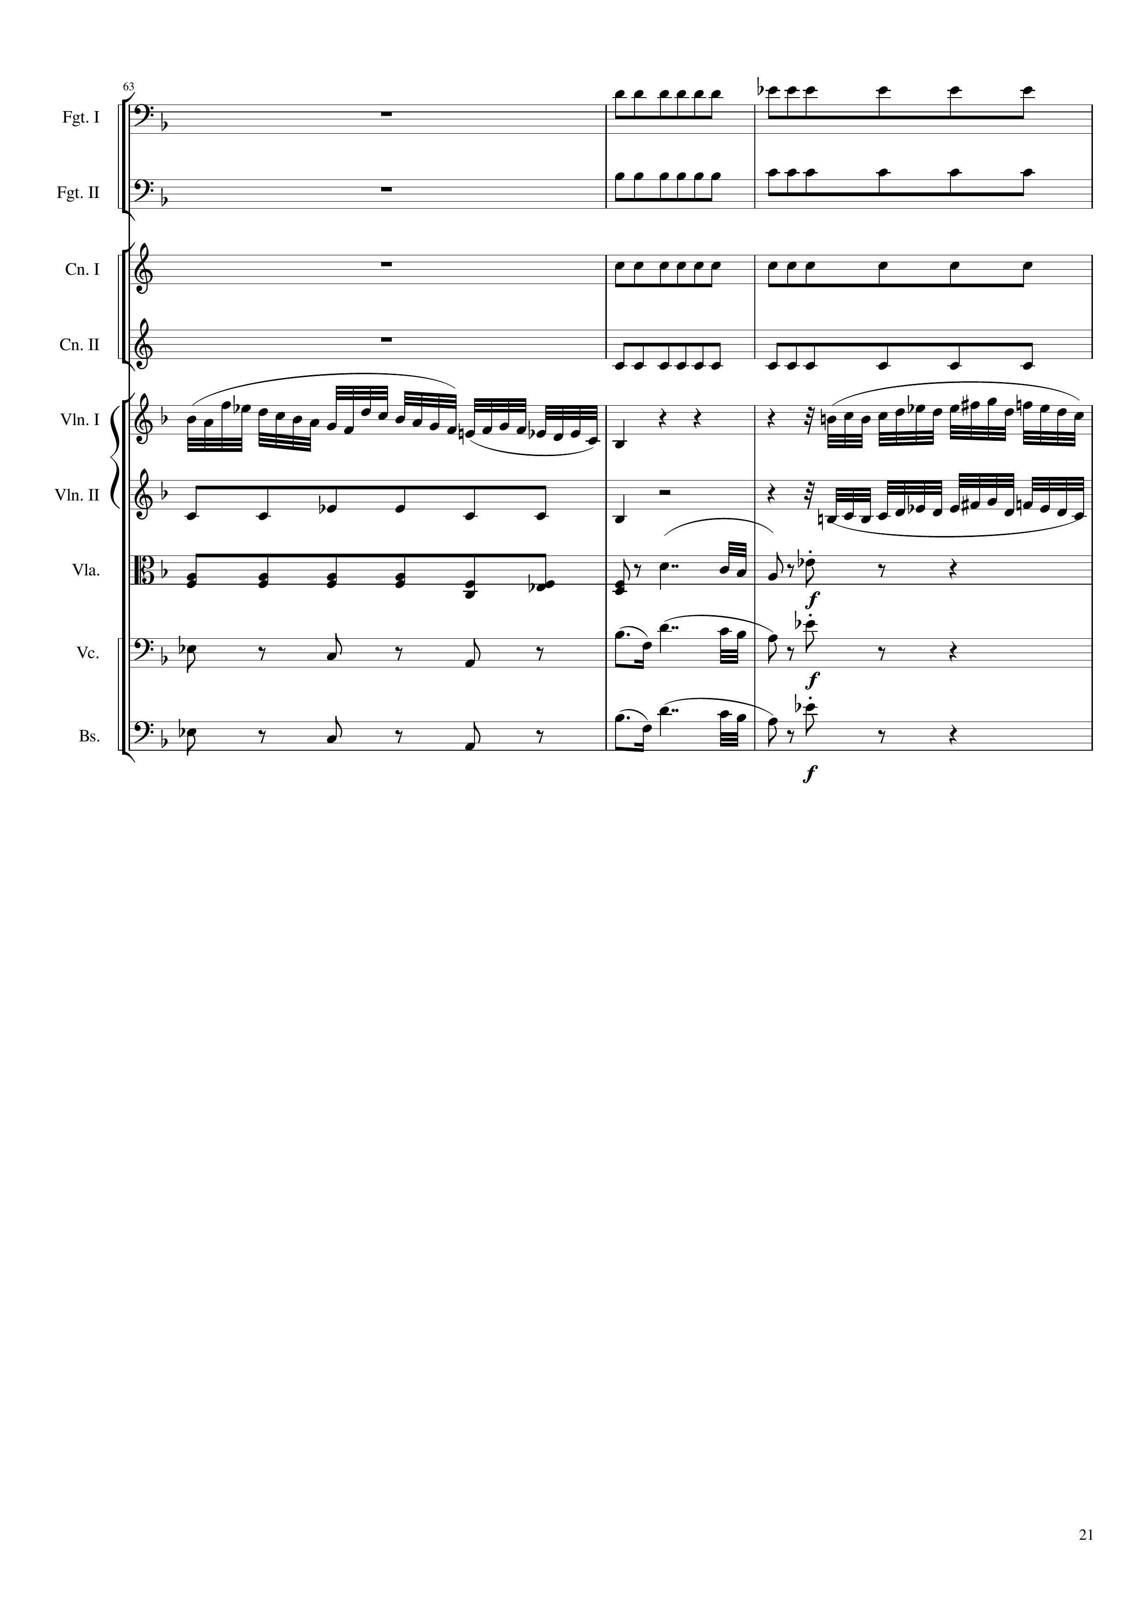
rhythm
rhythm
rhythm
rhythm
mel
mel
rhythm
mel
rhythm
mel
rhythm+harm
rhythm+harm
mel
rhythm+harm
rhythm+harm
mel
rhythm+harm
318
327

Slide 22
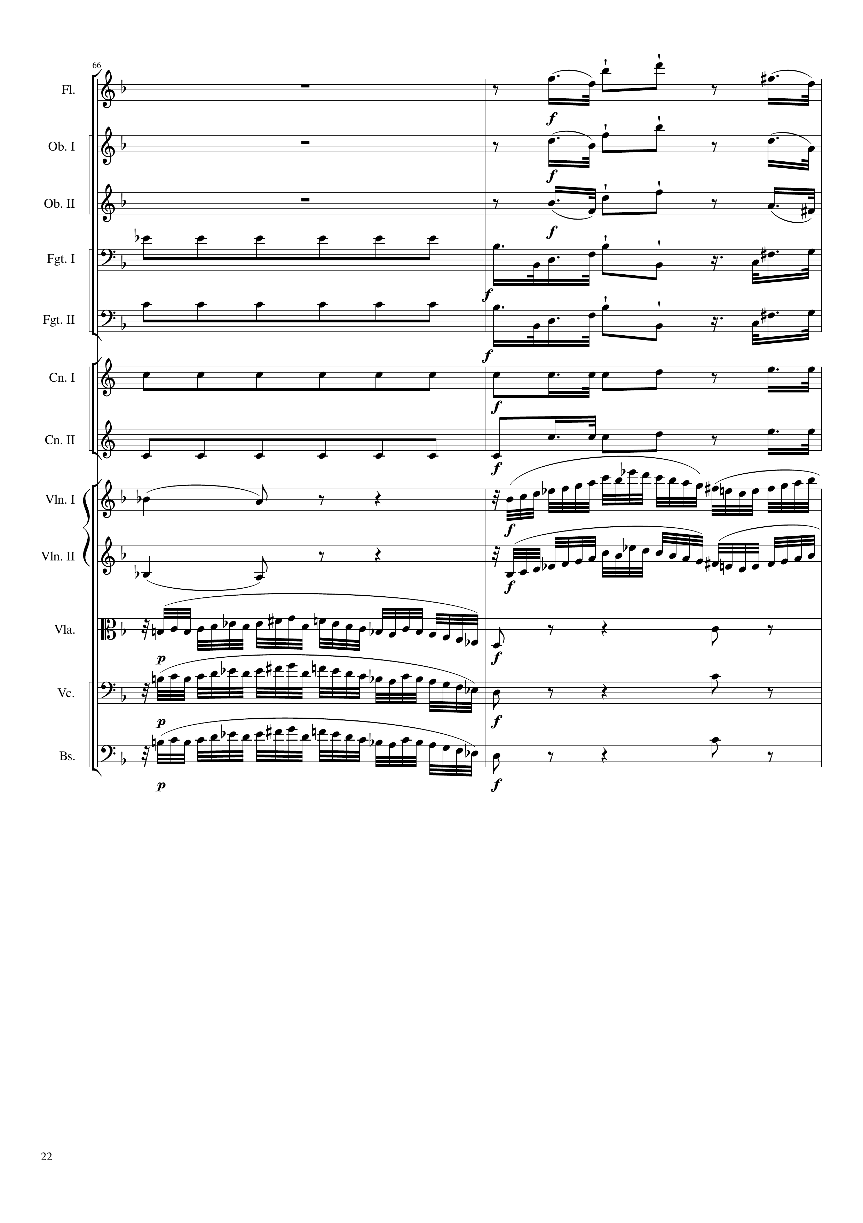
rhythm
rhythm
rhythm
rhythm
rhythm
rhythm
rhythm
rhythm
rhythm
rhythm
rhythm
mel
mel
mel
mel
mel
rhythm+harm
mel
rhythm+harm
mel
rhythm+harm
327
333

Slide 23
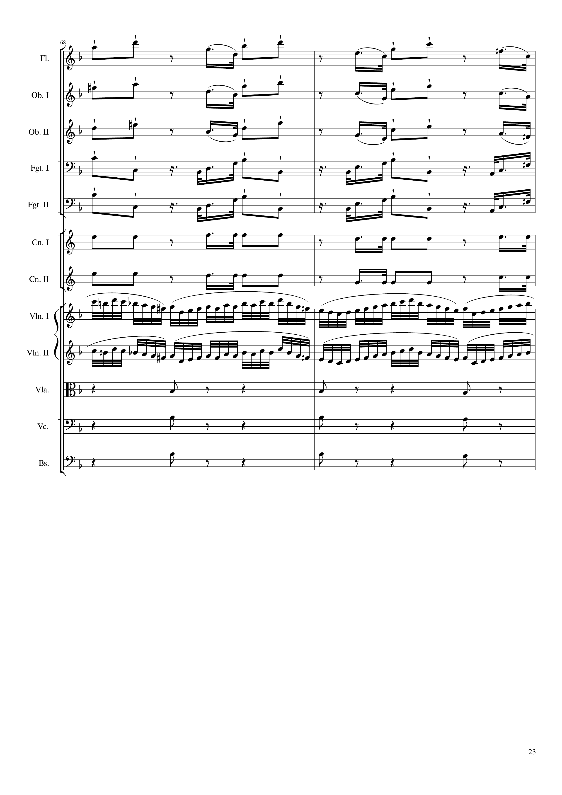
rhythm
rhythm
rhythm
rhythm
rhythm
rhythm
rhythm
mel
mel
rhythm+harm
rhythm+harm
rhythm+harm
333
339

Slide 24
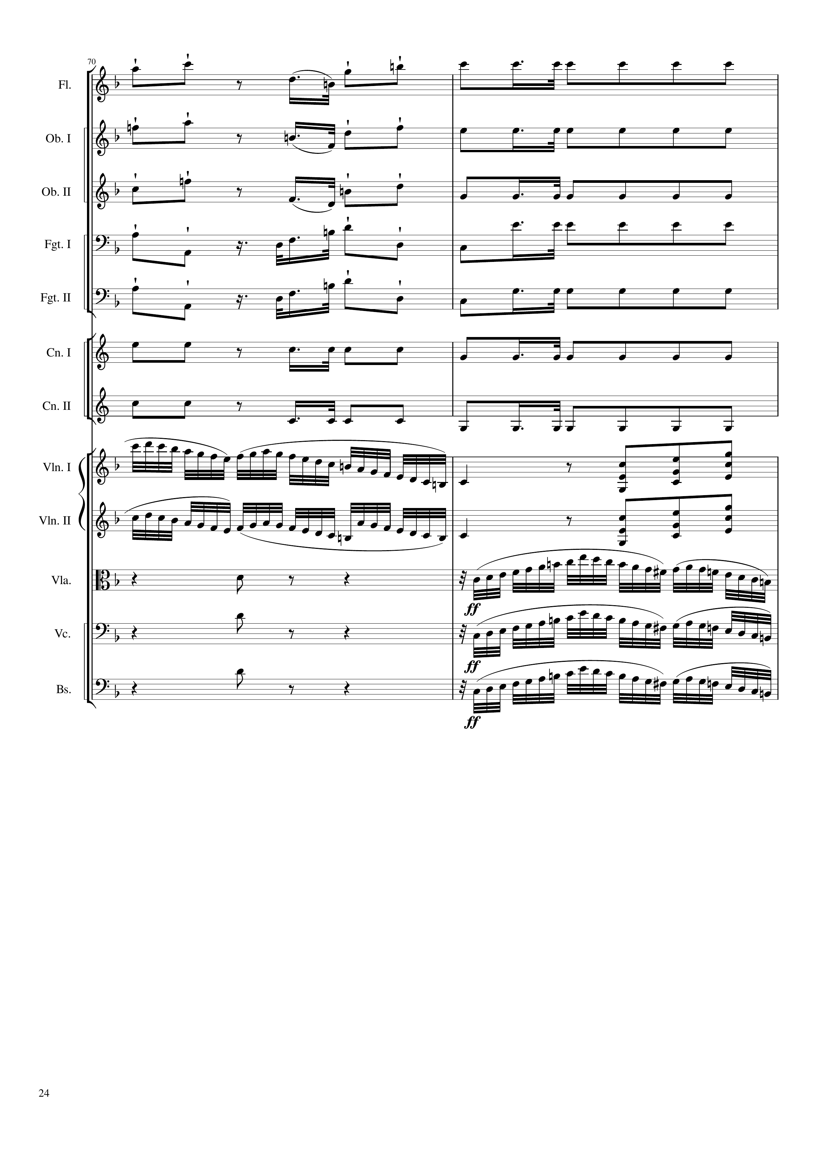
rhythm
rhythm
rhythm
rhythm
rhythm
rhythm
rhythm
mel
rhythm+harm
mel
rhythm+harm
rhythm+harm
mel
rhythm+harm
mel
rhythm+harm
mel
339
345

Slide 25
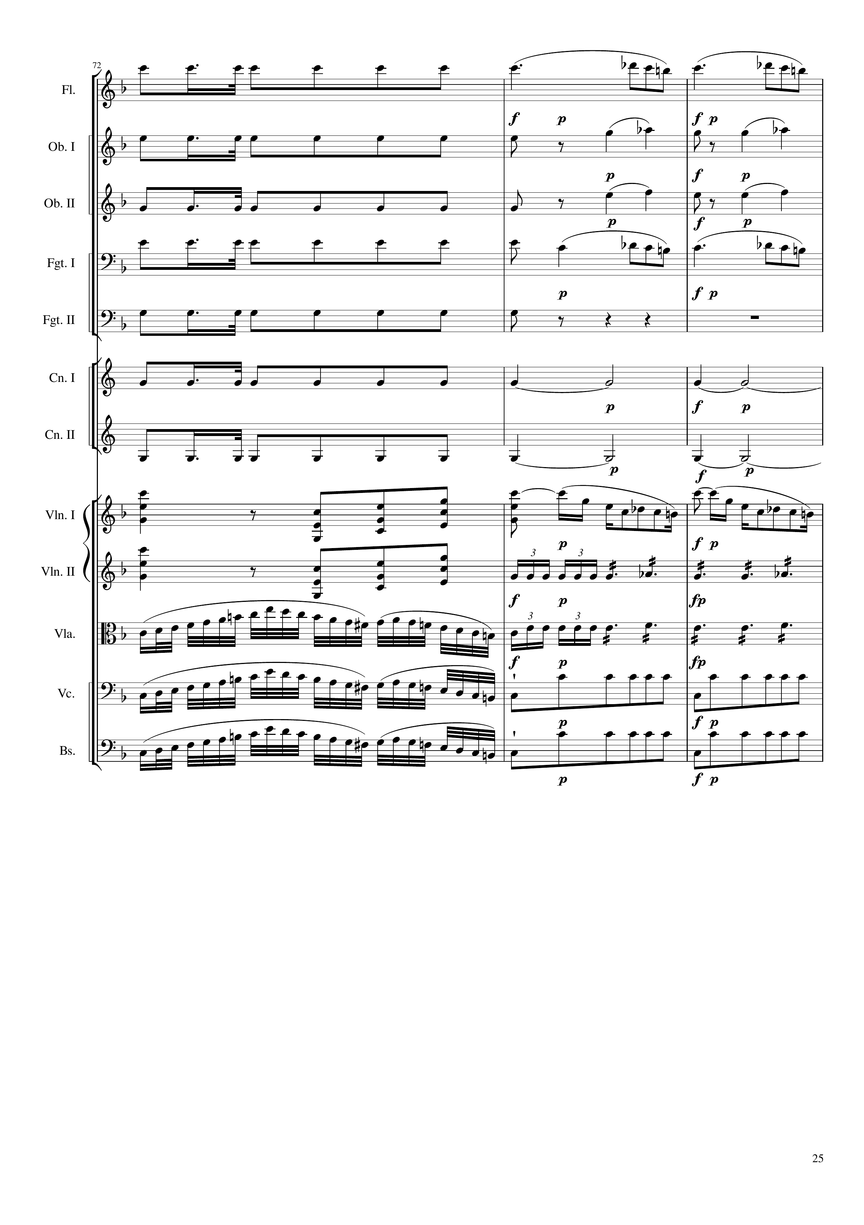
rhythm
mel
rhythm
harm
rhythm
harm
rhythm
mel
rhythm
rhythm
harm
rhythm
harm
rhythm+harm
mel
rhythm+harm
rhythm
mel
rhythm
mel
rhythm
mel
rhythm
345
348
354

Slide 26
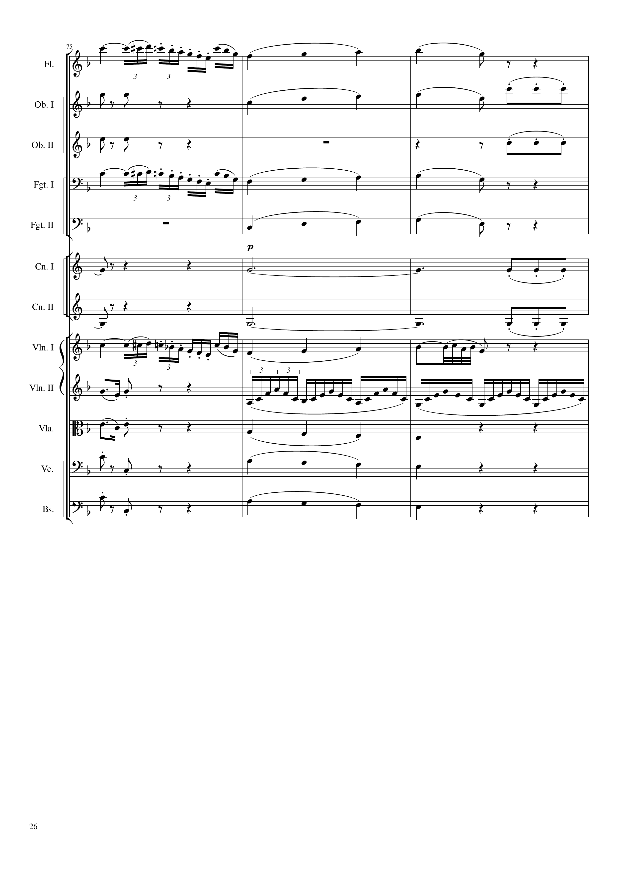
mel
mel
harm
mel
rhythm+harm
harm
rhythm+harm
mel
mel
mel
harm
harm
rhythm+harm
harm
harm
rhythm+harm
mel
mel+rhythm
rhythm
rhythm
rhythm
mel+harm
rhythm
mel+harm
rhythm
mel+harm
354
363

Slide 27
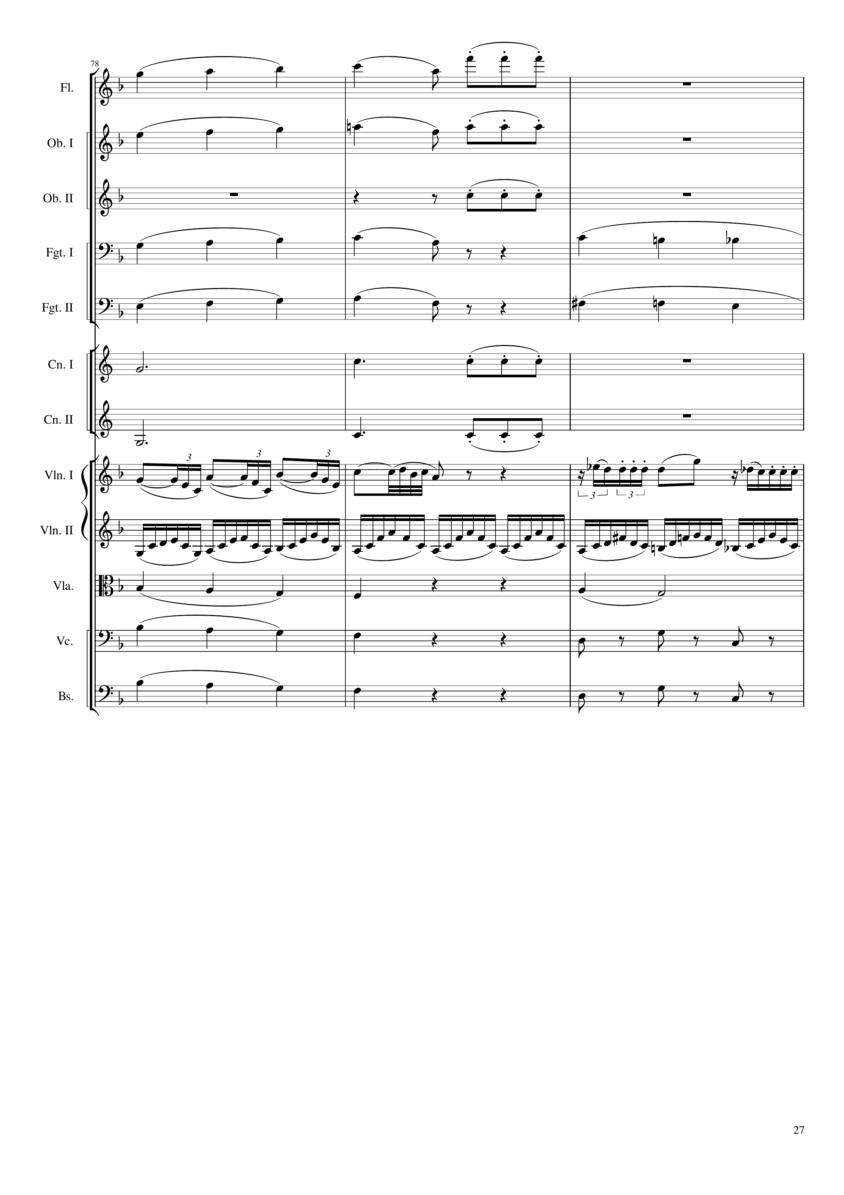
mel
rhythm+harm
mel
rhythm+harm
rhythm+harm
mel
harm
mel
harm
harm
rhythm+harm
harm
rhythm+harm
mel+rhythm
mel
rhythm
mel+harm
harm
mel+harm
rhythm+harm
mel+harm
rhythm+harm
363
372

Slide 28
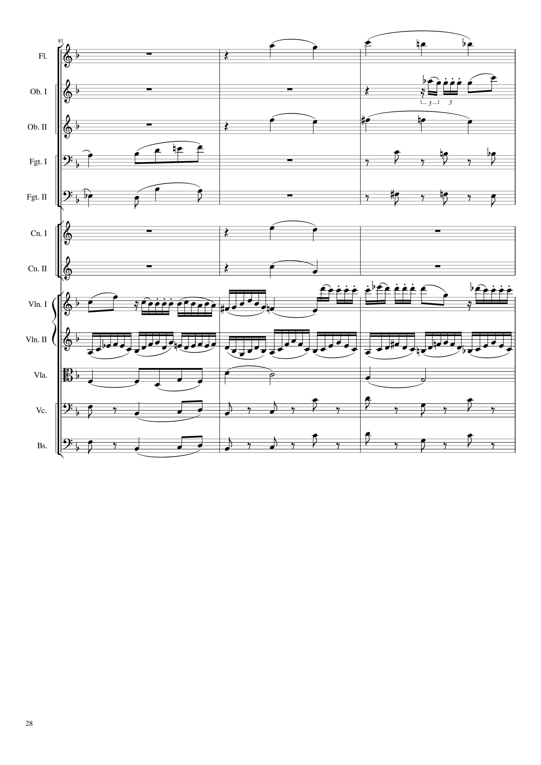
harm
mel
harm
harm
rhythm+harm
harm
rhythm+harm
harm
harm
mel
rhythm
harm
rhythm+harm
rhythm+harm
372
381

Slide 29
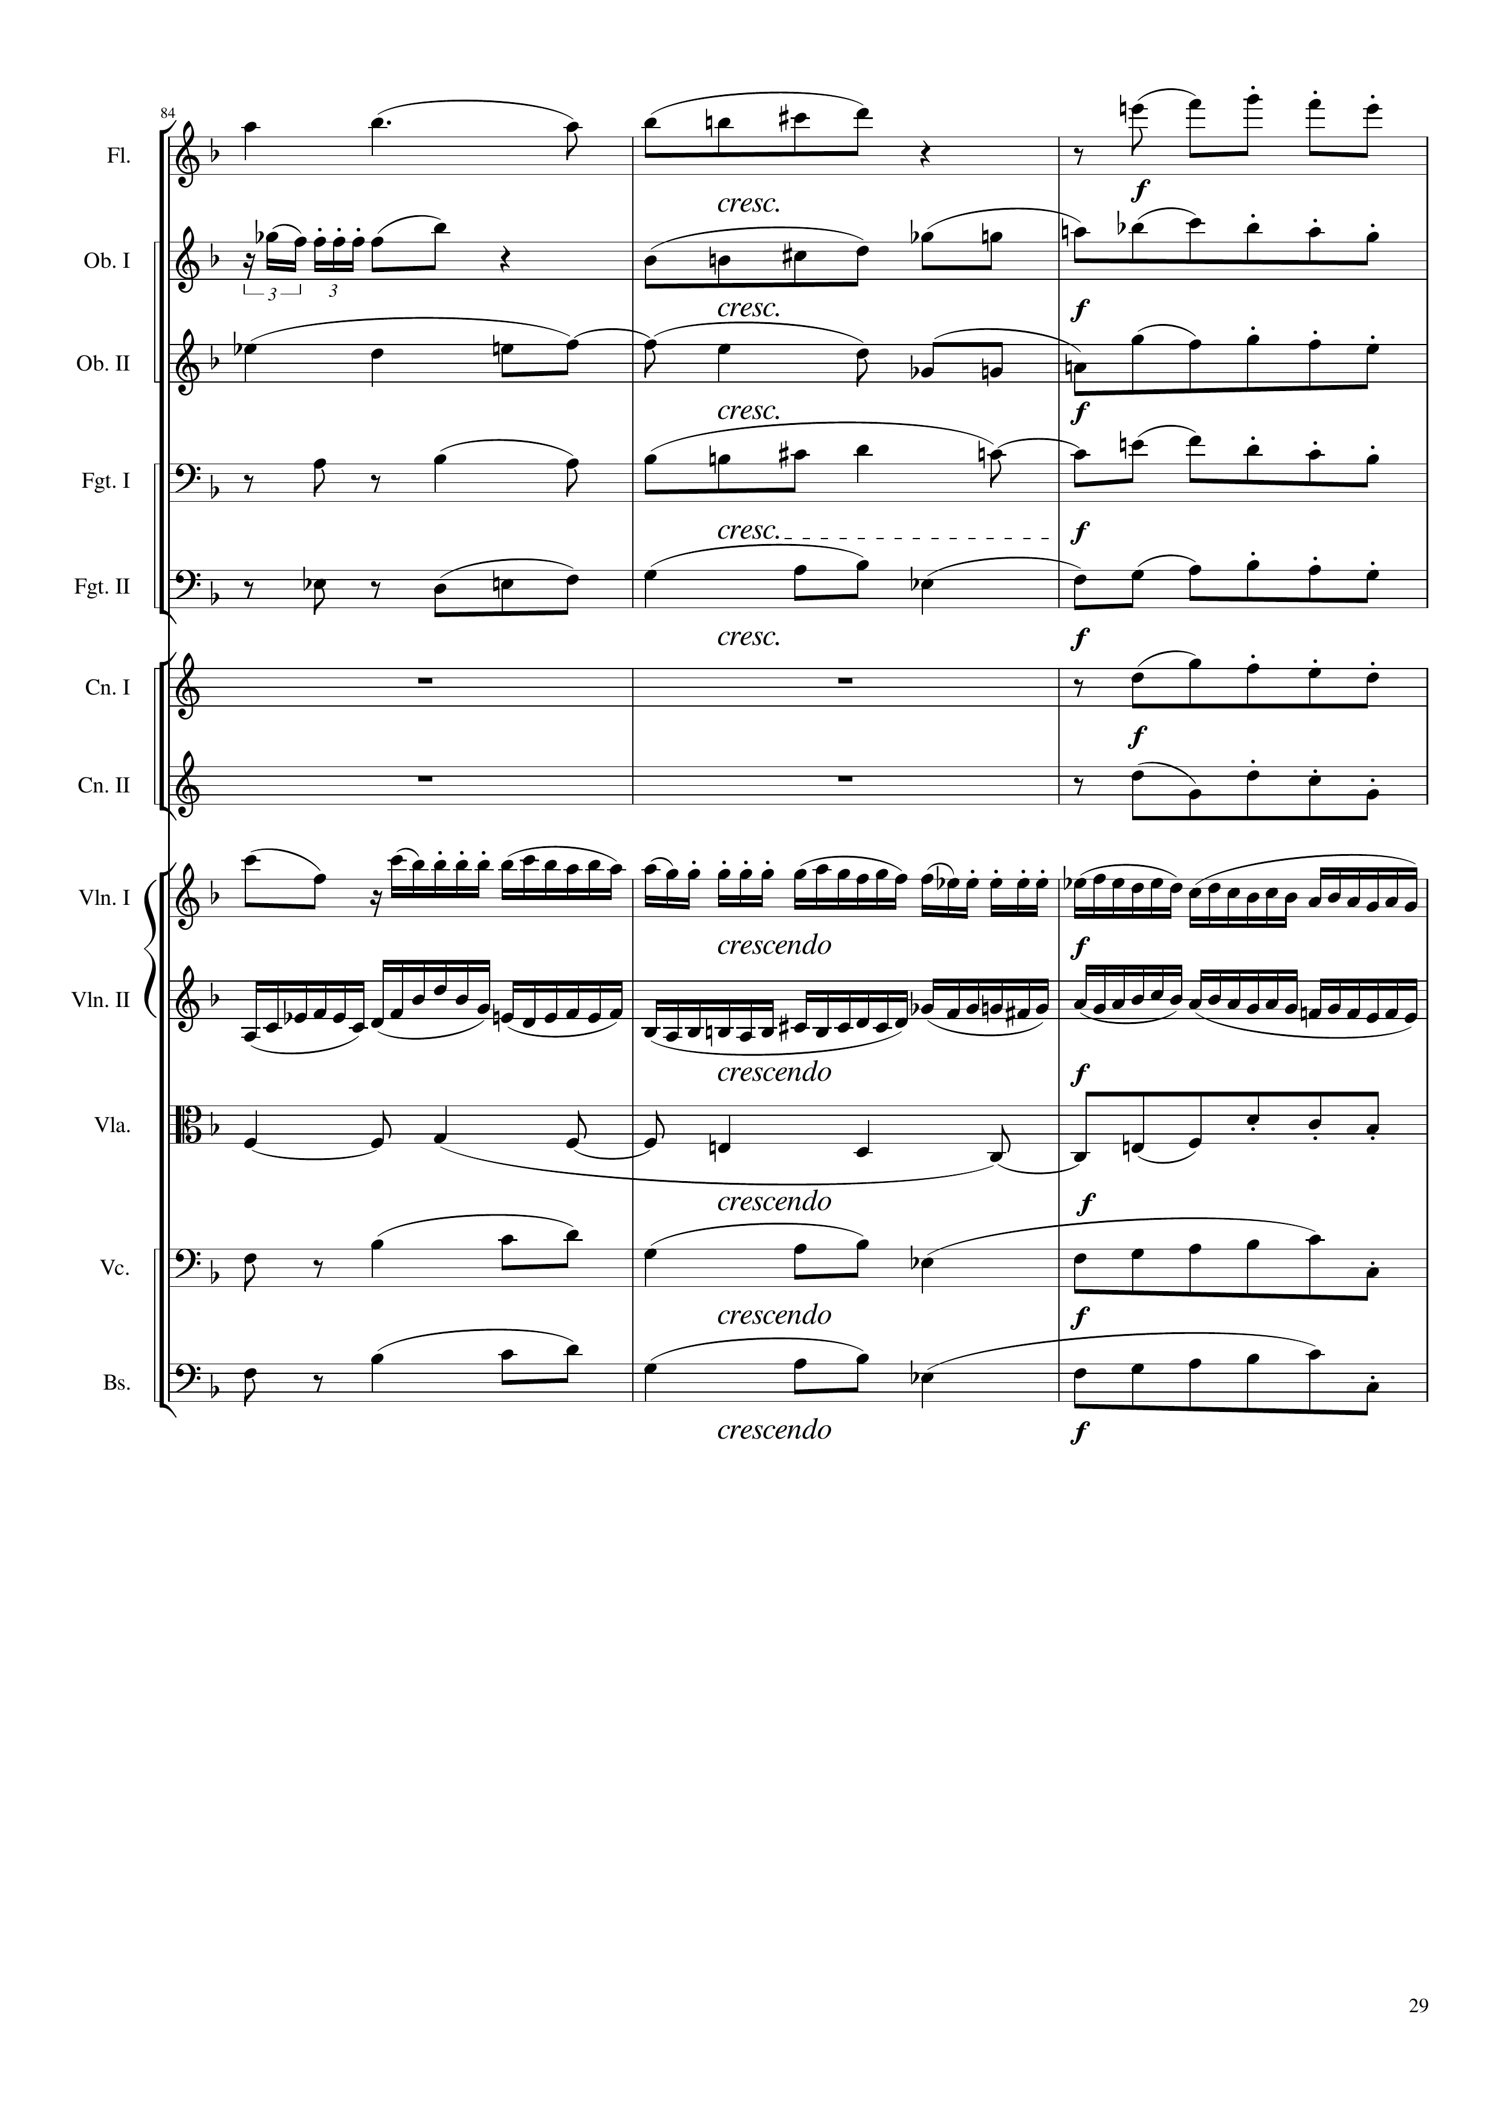
harm
mel+harm
mel
mel
harm
mel+harm
rhythm+harm
mel+harm
rhythm+harm
mel+harm
mel
mel+harm
mel
rhythm
mel+rhythm
harm
mel+harm
rhythm+harm
mel+harm
rhythm+harm
mel+harm
381
390
Notes:
24:40

Slide 30
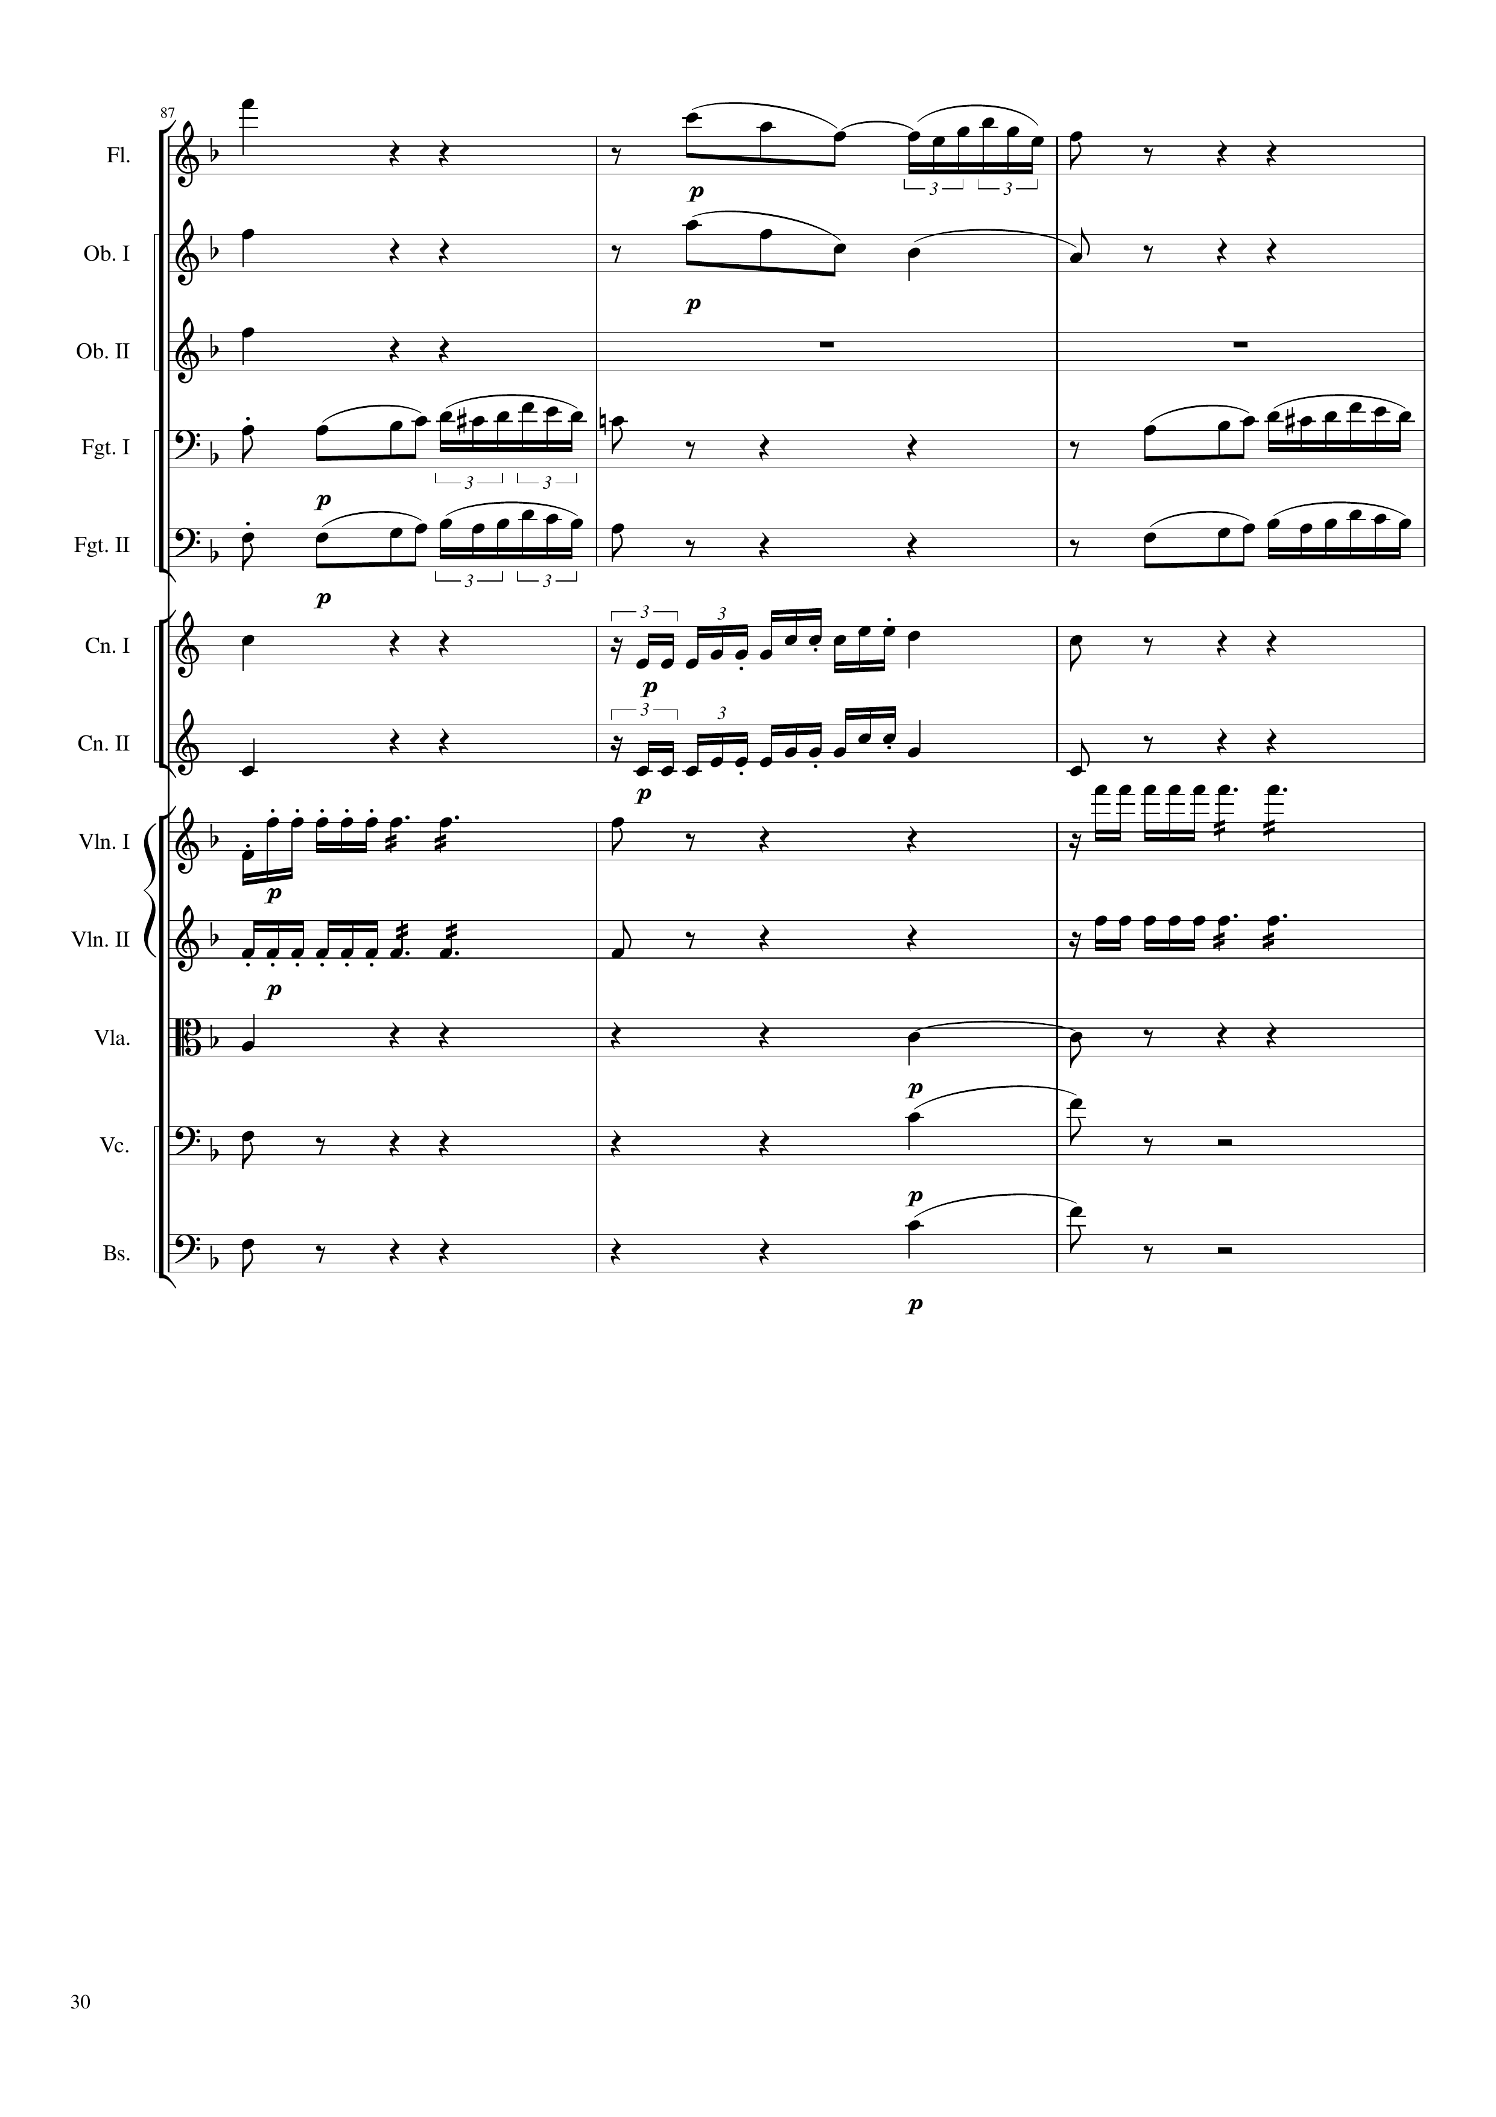
mel+harm
mel
mel
mel
mel+harm
mel+harm
mel
mel
mel+harm
mel
mel
mel
mel
mel+harm
mel
rhythm
rhythm
rhythm
rhythm
mel+harm
harm
mel+harm
harm
mel+harm
harm
390
399

Slide 31
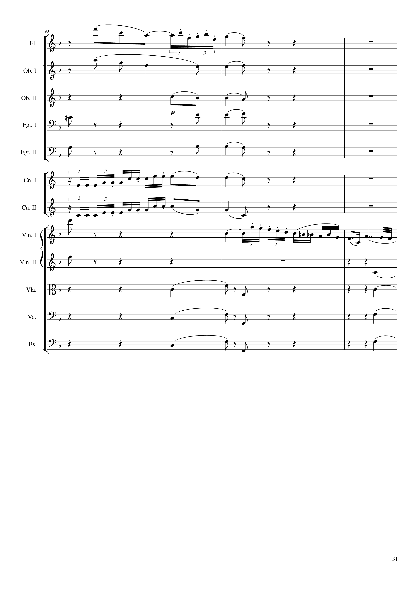
mel
mel
harm
mel
harm
mel
harm
mel
mel
rhythm
mel
rhythm
harm
harm
harm
harm
harm
harm
harm
399
408

Slide 32
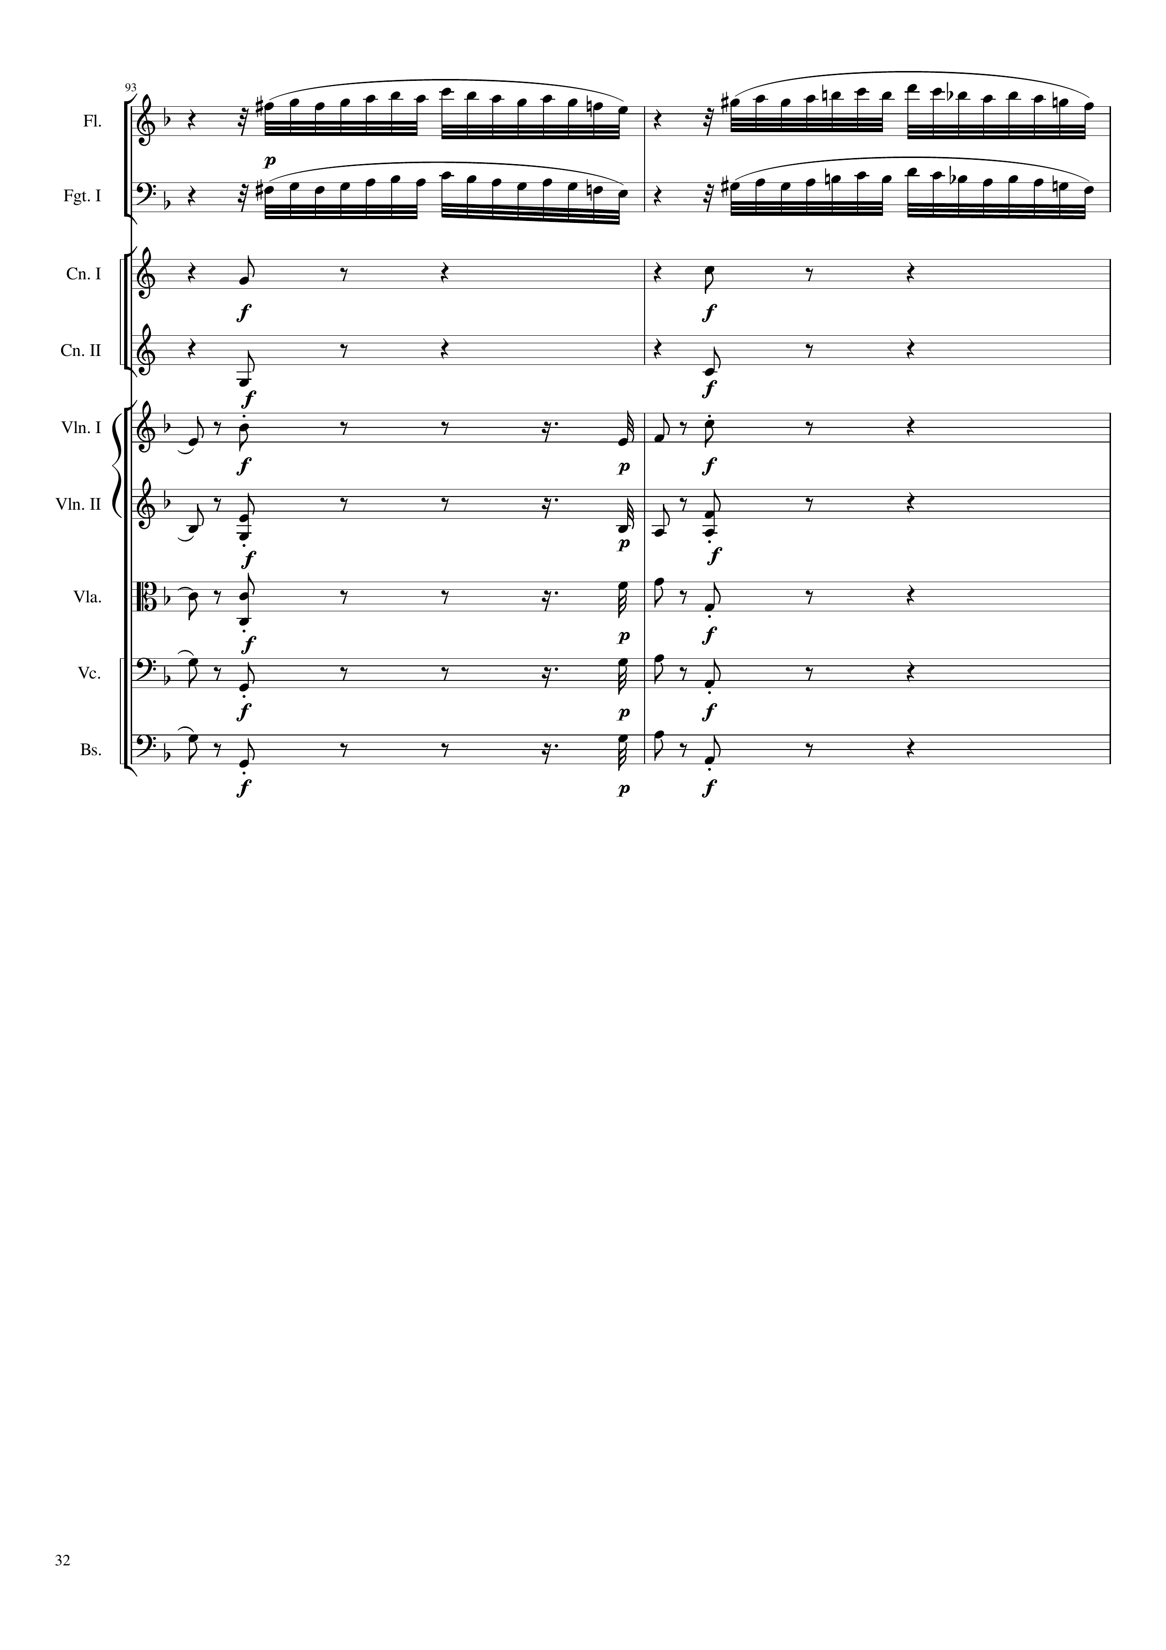
mel
mel
rhythm+harm
rhythm+harm
rhythm+harm
rhythm+harm
mel
rhythm+harm
rhythm+harm
harm
rhythm+harm
rhythm+harm
harm
rhythm+harm
rhythm+harm
harm
rhythm+harm
rhythm+harm
harm
rhythm+harm
rhythm+harm
408
414

Slide 33
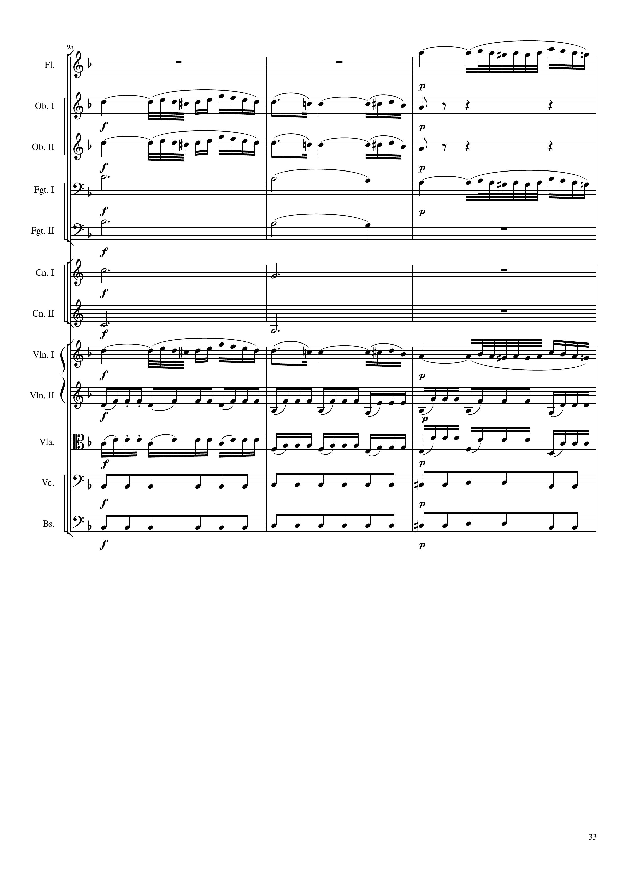
mel
mel
mel
harm
mel
harm
harm
harm
mel
rhythm
rhythm
rhythm
rhythm
414
423

Slide 34
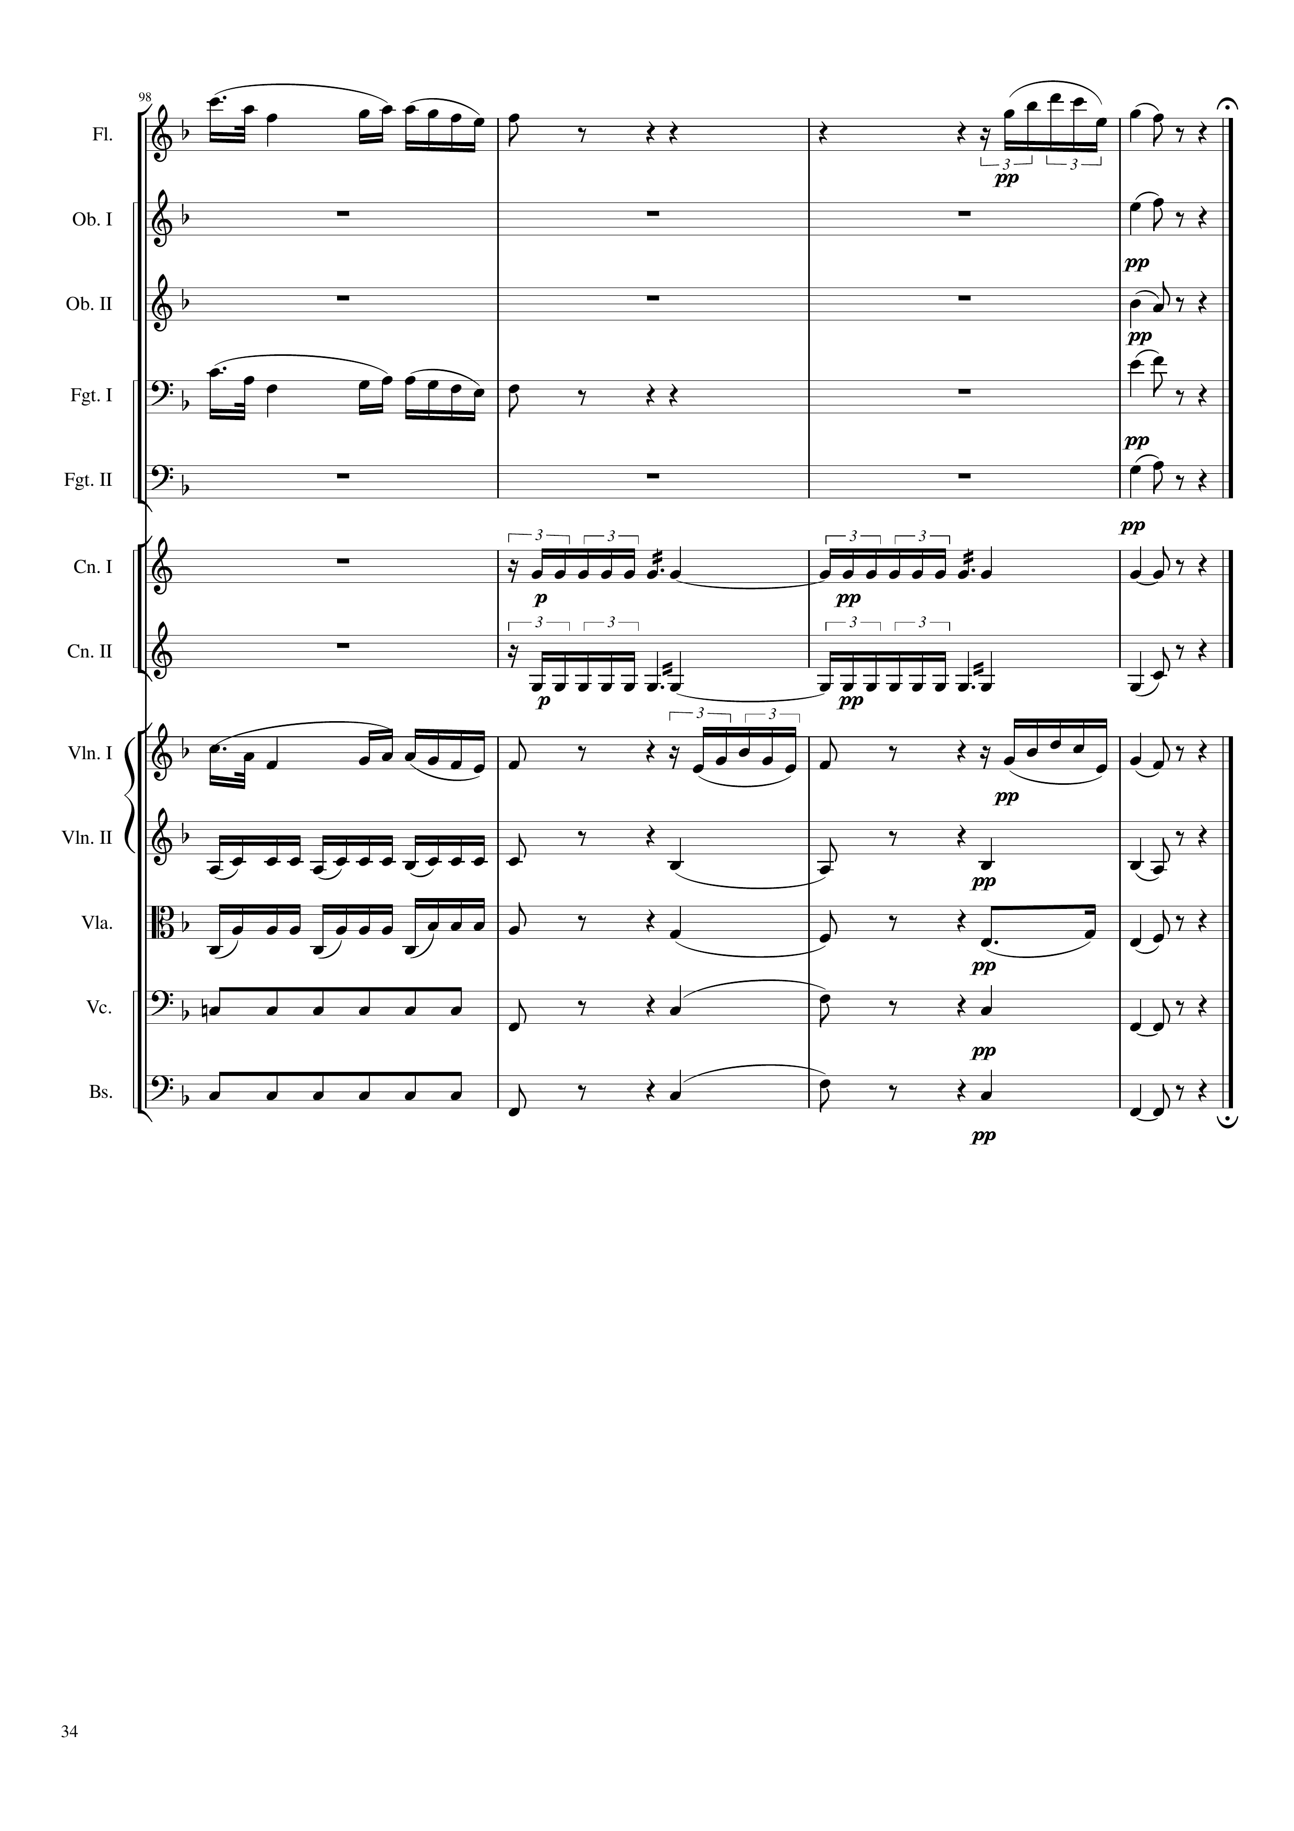
mel
mel
harm
harm
mel
harm
harm
rhythm
harm
rhythm
harm
mel
rhythm
harm
rhythm
harm
rhythm
harm
rhythm
harm
423
435

Slide 35


